Slide 1

TRANSFORMAÇÃO DIGITAL: REINVENTANDO A OPERAÇÃO E A ADMINISTRAÇÃO NA SAÚDE
Eixo Temático – Eficiência Operacional
Jaime Gama
São Paulo, 07/11/2018

Slide 2
Debate
Promover a discussão sobre como a tecnologia pode melhorar os processos, reduzir desperdícios, otimizar custos e aumentar lucros. Alguns aspectos:
-Ferramentas para melhorar a performance da gestão e também da assistência;
-Investimento necessário para aplicar essas tecnologias nas diferentes realidades brasileiras;
-Capacitação dos profissionais para usar as novas tecnologias sem fazer com que se sintam substituídos por elas.
Lilian Quintal Hoffmann, Superintendente Executiva de TI da Beneficiência Portuguesa de São Paulo
Antonio Carlos Onofre Lira, Superintendente de TI da Seguros Unimed
Milene Rosenthal, Co-fundadora da TelaVita
Chao Lung Wen, Médico e Chefe da disciplina de Telemedicina do Curso de Medicina da USP
Ricardo Reis, Gerente de Qualidade do Hospital e Maternidade Santa Joana

Slide 3







Jaime Gama
10 anos – Indústria (Belgo, Alcan)
03 anos - Consultoria Própria
20 anos - Saúde e Professor Pós Graduação

Slide 4


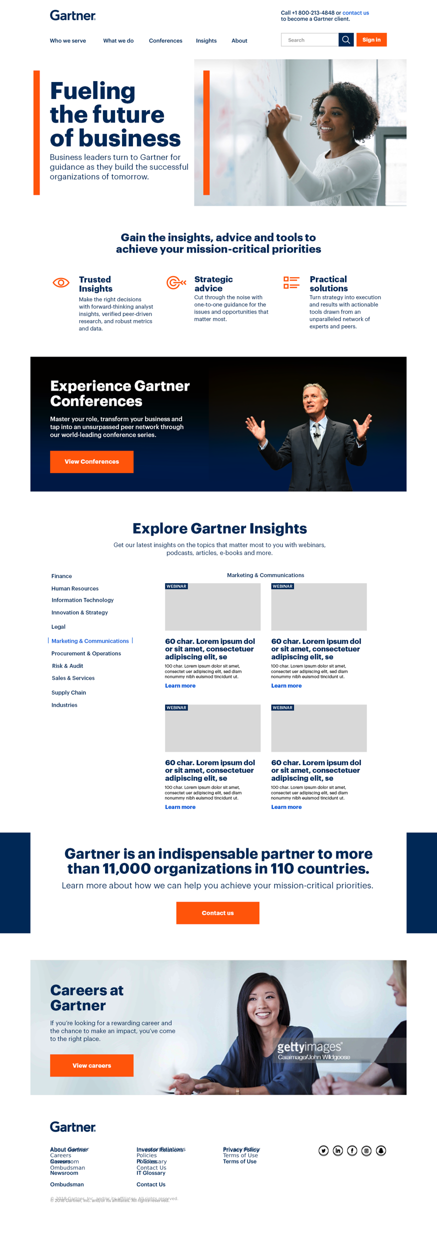
Gideon Gartner 1935
Analista de tecnologia em Wall Street
Fundou o Gartner em 1979 para prover pesquisas para Fabricantes e Usuários
Empresa de apoio a decisão via aconselhamento/ coaching contínuo para geração de insights para que nossos clientes tenham a melhor tomada de decisão de negócios

Slide 5

“O poder do coaching: você deve dar às pessoas o caminho para encontrar respostas, não as respostas”
We’re the world’s leading research and
advisory company

Slide 6


Uso racional e otimizado dos recursos disponíveis
Porto – Santiago de Compostela (2017)
Hotel Cabine em Nova York (2018)
Sharing Economy, Co-living, Co-working, E-services

Slide 7
TRANSFORMAÇÃO DIGITAL: REINVENTANDO A OPERAÇÃO E A ADMINISTRAÇÃO NA SAÚDE
Uso racional, otimizado e inteligente de recursos, com pessoas engajadas
Lean Thinking

Slide 8
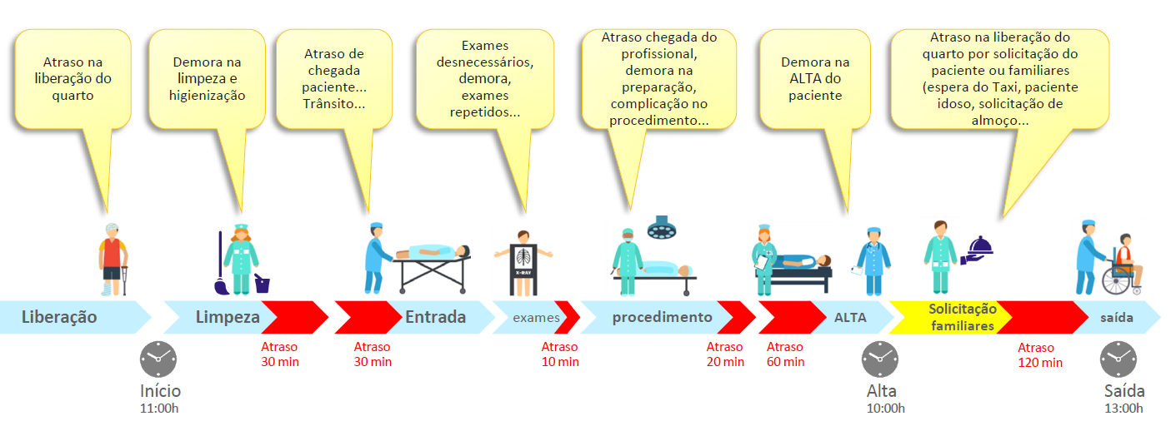
A passagem de valor de cada etapa de qualquer processo deve ser um primor!!!!!

Slide 9


Slide 10

O que é Transformação Digital?

Slide 11
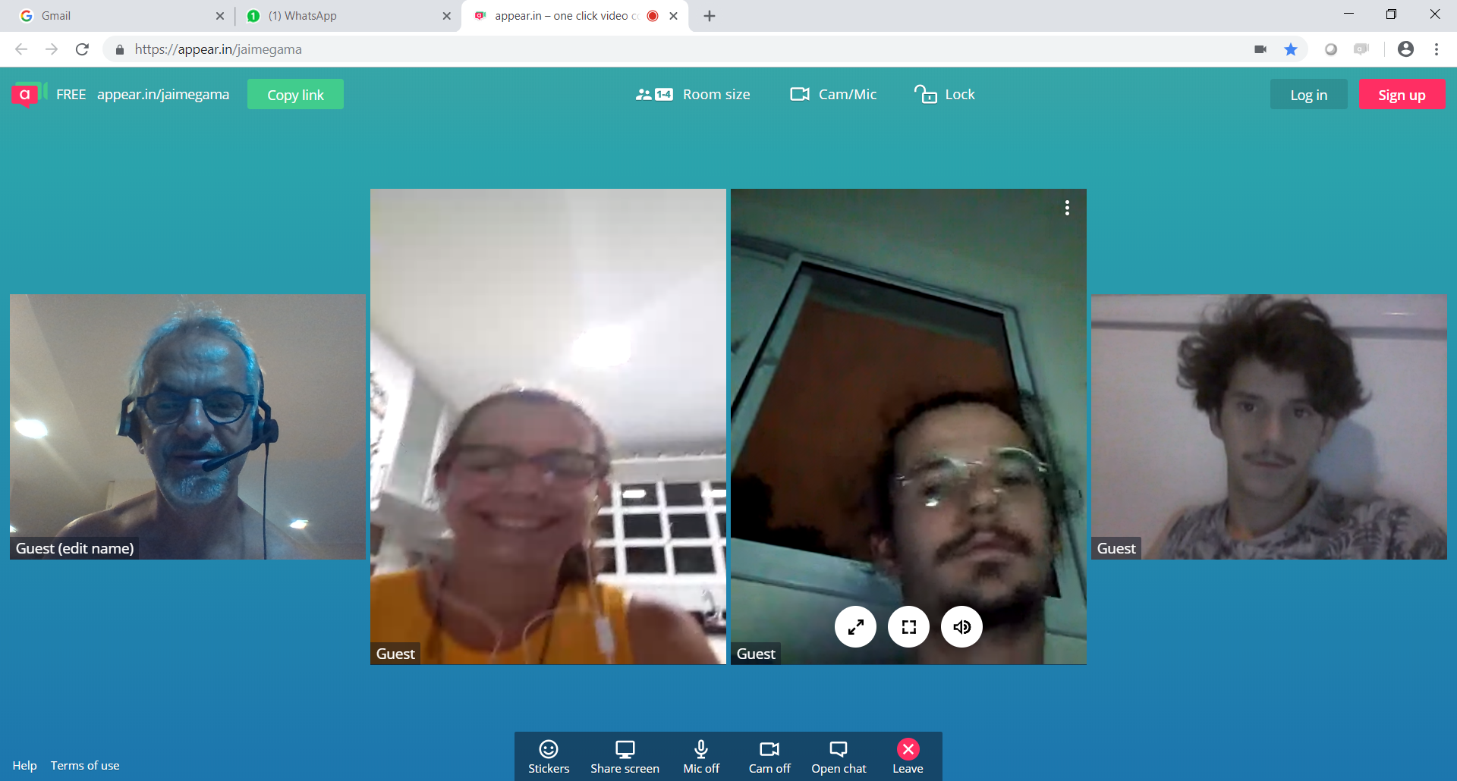
Família Digital

Slide 12
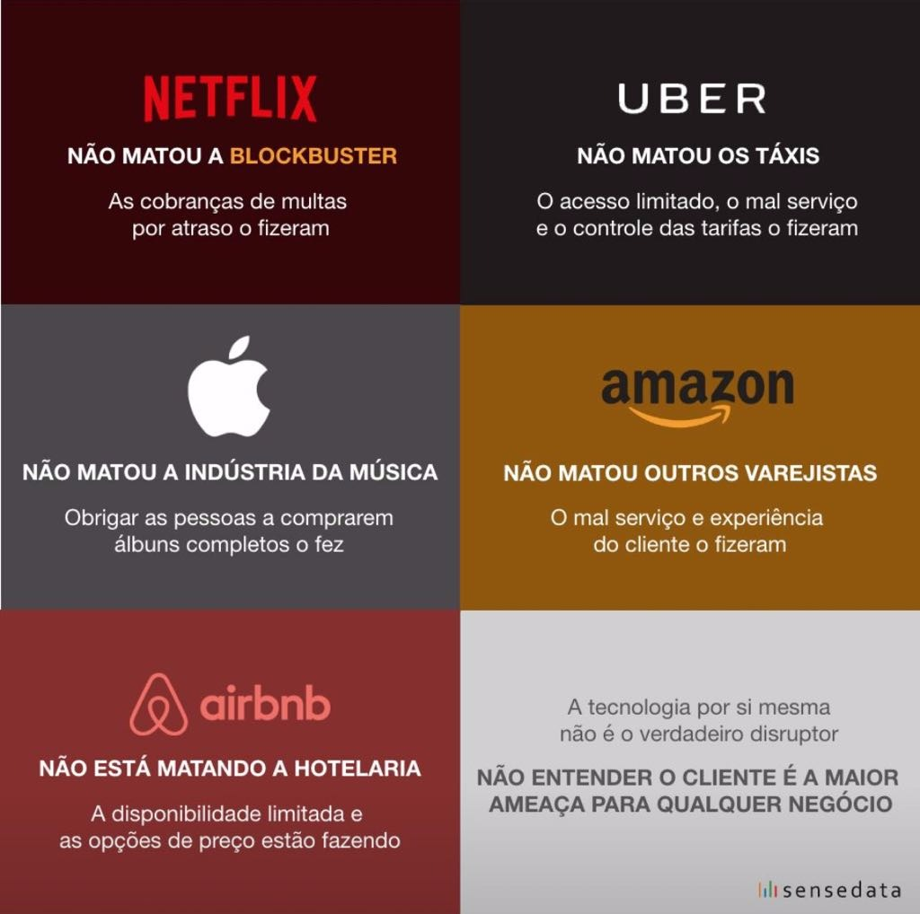
????????? (NOVO PLAYER DISRUPTIVO)
NÃO MATOU A INDÚSTRIA DE PLANOS SAÚDE
Qual afirmativa vocês escreveriam aqui?
????????? (NOVO PLAYER DISRUPTIVO)
NÃO MATOU A INDÚSTRIA DE HOSPITAIS
Qual afirmativa vocês escreveriam aqui?

Slide 13
Tempos Exponenciais
Mundo VUCA (volátil, incerto, complexo e ambíguo)
Mindset Digital
Transição de liderança
Novas Gerações (Y, Z)
Transformação Digital
Indústria 4.0
Novo consumidor
Diversidade
Propósito
Mundo Plano, Quente, Lotado
Ser Antifragil
Disrupção
Era dos Makers
Impressoras 4D
Colonizadores do espaço
Carros autônomos
Homem “Fisital”
Energias verdes
DNA perfeito
Robôs, chatbots
Cloud, IoT
Inteligência coletiva
Machine to Machine M2M
Startups
Sharing Economy
Drones
IA, Machine Learning
Bio-tech
Nano-tech
Neuro-tech
Sustentabilidade
Aceleração dos bits
Big Data, Data Lake
Destruição Criativa
Blockchain
Hackaton
Co-criação
Economia circular / solidária
Educação de alto impacto
Lean Thinking

Slide 14


Otimização digital é o uso da tecnologia digital para melhorar os processos operacionais e os modelos de negócios existentes
Transformação digital é o processo de explorar as mais recentes tecnologias e práticas digitais para criar um novo modelo de negócios digital robusto, com alta inteligência e efetividade

Slide 15


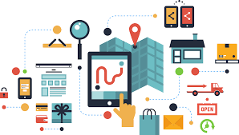

Digitização
Digitalização
Transformação Digital
Em qual ponto o Segmento de Saúde está?

Slide 16
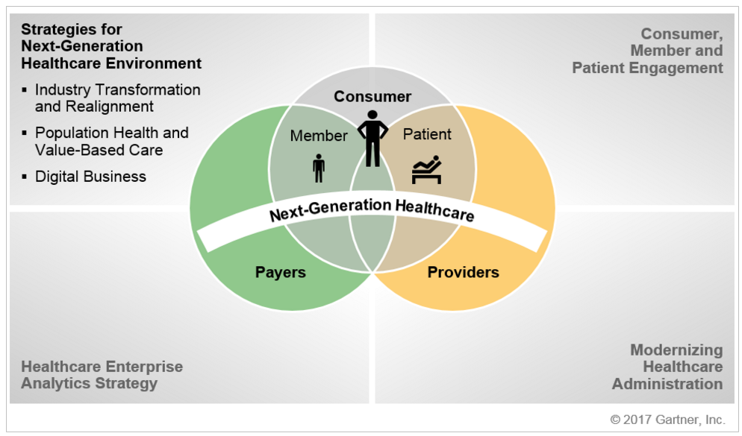
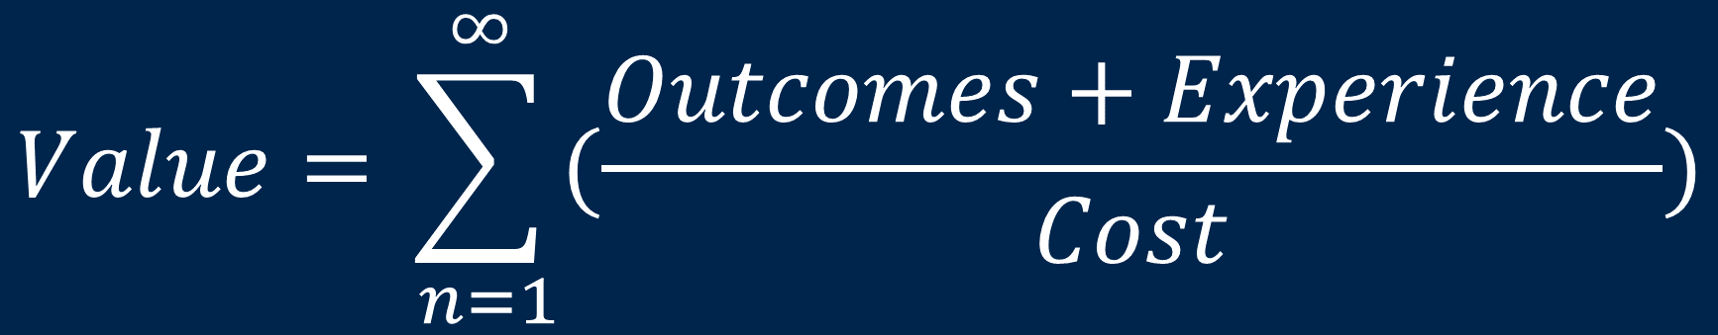
Agenda de Healthcare
Prioridades das Organizações do Setor
$$\text{Value}=\sum_{ n=1}^{∞}{(\frac{Outcomes+Experience}{Cost})}$$
Notes:
Myth 1: Agile, DevOps and Mode 2 are synonymous — Agile is the most common capability that organizations start with in Mode 2, and it's a great place to start because it teaches many of the principles that underpin bimodal. But agile (and other iterative methods) is equally applicable to Mode 1 initiatives. Likewise DevOps. (See "The End of the Waterfall as We Know It," G00291841). Further, we anticipate that Mode 1 will adopt many of the approaches, methods and processes for which Mode 2 acts as a trailblazer, not least iterative methods.
Myth 2: Bimodal is about speed, software development, less rigor — Bimodal is actually about the enterprise developing (or relearning) a capability to innovate and explore new opportunities, develop new products, new business models. Usually with technology, usually with software — but that's not what defines it and the software content may be a very small part. The key value proposition of Mode 2 is managing uncertainty and agility. Speed can be a powerful trait when looking to manage in an uncertain environment and create agility, but don't conflate speed and agility. But Mode 2 is not simply to plow through the application backlog faster. It's about innovating, exploring. Ultimately, Mode 2 will deliver less stuff, of greater value, faster. Mode 2 methods are designed to be exploratory. Exploring and learning about something new can require more rigor than following a well-known path. Mode 2 introduces tools that enable the enterprise to take on projects with greater uncertainties associated with them, and potentially with greater risk. To do this well requires rigor.
Myth 3: Mode 1 is static, business as usual, and is only focused on incremental continual improvements. Nothing could be further from the truth — see renovating the IT core below.
Myth 4: Mode 1 will disappear. Mode 1 as we know it today will disappear, because of the renovation described below. But organizations will always have initiatives that have low levels of uncertainty associated with them, and ones that have high uncertainty — which need managing, leading and governing differently. Things that once were uncertain will take on greater certainty and so likely transition from a Mode 2 style of work to a Mode 1 style. Other than startups, very few enterprises would be operating only in Mode 2 (for organizations that are 100% agile, see Myth 1). So Mode 1 is here to stay.

Slide 17

Platform Digital Health Business
Wearable
Ecosystem
Partners
Customer Experience Platform
Ecosystem
Platform
Web Portal
Data & Analytics Platform
Event Stream Analytics
Automated
Processes
Patient
Reported
Outcomes
Information
System Platform
IoT Platform
Clinical Command
Center
Cardiac
Monitoring
Medication
Adherence
Weight
Management
Source: Mark E Gilbert, Research Director Healthcare Strategy
Notes:
Placeholder for text (substitute your own text; delete when not used)

Slide 18
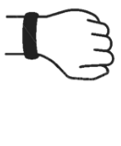
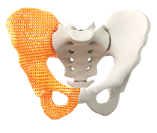
The Digital Care Delivery Framework for Healthcare Provider CIOs (2018, oct)
Remote Monitoring
Wearables
Speech Analysis & Diagnosis
3D Printing
Care Management
Wellness Prevention
Telehealth
Precision Medicine
Patient
The Digital Care Platform Is ...
A Clinical Colleague and Mentor
A Patient Advisor and
Health Coach
A Virtual Assistant
A Virtual Patient Connection
EHR
AI Imaging
Interpretation
Treatment
Investigate
Clinician
Pop. Health
Management
External Clinical Decision Support
Diagnose
Self Monitoring
Open Notes
Predictive
Analytics
Algorithmic
Medicine
VPHA
Source: Mark E Gilbert, Research Director Healthcare Strategy
VPHA – Virtual Personal Health Assistant
Notes:
So what is digital care delivery? It is the fusion of all care delivery technologies: inpatient, ambulatory, home and personal. Synchronous and asynchronous.
Digital Care Delivery virtualized care delivery to become delivered at the right time, anywhere and anytime. It achieves breakthroughs in outcomes and cost. But more importantly; achieves breakthroughs within consumer and physician experience.
Some examples:
1. Doctors spend approx. 30% of their time asking algorithmic questions, which are well-handled by the automated system. Doctors spend another 30% of their time documenting the encounter, - 10% to 15% of their time entering orders,. Automation of this first part of the encounter. We see increased use of medical chatbots and VPAs that work with the clinician to help eliminate low acuity conditions.
Participating clinicians report that using these types of system can often reduce the time it takes to gather and review patient information, confirm a diagnosis, select treatment options and document the encounter to less than two minutes. These tools have also been shown to handle required documentation, which can be automatically inserted into an electronic health record (EHR) via HL7-based integration (one of our greatest challenges). These systems can be configured to set up appropriate follow-up care as well.
2. We see wearable and remote monitoring devices worn by the patient/client to monitor vital signs such as blood pressure, heart rates, body temperature and sleeping patterns. They are not only worn for medical reasons – they are increasingly popular with people to track their fitness – but can help people manage long term conditions.
3. Algorithmic medicine, predictive analytics combined with population health management algorithms to detect those cohorts most at risk are showing promising results. And when combined with clinical knowledge and skills (as opposed to replacing them) we see the synergistic effect that improves care outcomes, avoid adverse events, and can reduce waste.
4. We also see an increasing level of engagement between te patient and their clinician outside the four walls of the clinic or hospital through the use of telehealth (70% of patients found a video visit a positive and preferred experience compared with having to travel and meet face to face with their clinicians )
There are many others on this slide. Did I mention we have a Hype Cycle where you can go to track each and every technology within the digital care delivery hype cycle and where your will fined detailed evidence of benefit, time to maturity and advice on integration and adoptoing with the enterprise. Did I also mention we have a great team of analysts that can provide you with deep insight on the technology, use cases, vendors and outcomes?
Digital Care Delivery automates the heavy lift of data capture, analysis and probability calculations, sifting through evidence. It liberates the clinician from a requirement to have direct contact with the patient in order to treat them, it engages the consumer in the care plan by having access to it, being able to contribute to it and with the use of digital tools to help the patient comply with their plan. It integrates the physician into 24/7 virtual care of patients.
Gartner envisions Digital Care Delivery being enabled though a digital platform. This is no different that any other digital business. The Digital Care Delivery platform creates transformative value. It supports the new business model of health. It also supports the digital transformation of healthcare (virtual care, value based care, AI augmented care ).
Outcomes and Benefits:
Improved Quality and Experience
Care Virtualization
Knowledge Management
Advanced Diagnostics
Advanced AI and Clinical
Decision Support
Real-Time Surveillance

Slide 19
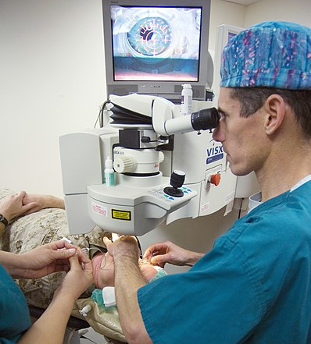
Strategic
Planning
Assumption
  By 2020 40% of healthcare providers globally will find their EHR will not support their care delivery needs
Source: Mark E Gilbert, Research Director Healthcare Strategy
Notes:
Placeholder for text (substitute your own text; delete when not used)
Gartner's latest Healthcare Provider CIO survey found that while EHR was THE number one investment, and its been the number one investment for over 4 years running:
80% of CIOs had yet to realise significant ROI from that investment.
The majority reported they faced significant challenges in their digital migration. Clinical engagement, Usability and vendor configuration challenges were in the top 5 issues.
A recent AMA survey found only 34% of physicians stated they were satisfied or very satisfied with their HER.
It is time to recognize a fact. The EHR can't do it all.
<animate>
EHR's are not going to satisfy all our care delivery needs as our industry transforms both digitally and from repair care to health. They don't effectively engage physicians, consumers, extended care givers, or extended care teams. They don't provide the capabilities required to create a fusion of clinical care, advanced medical technologies, AI and algorithmic medicine.
It is time for a new approach for digital care delivery. A platform approach. Yes, one that the EHR is a part of. But no, the EHR doesn't create it.
In this 30 minute session we are going to address the why, what and how of digital care delivery
<transition>

Slide 20
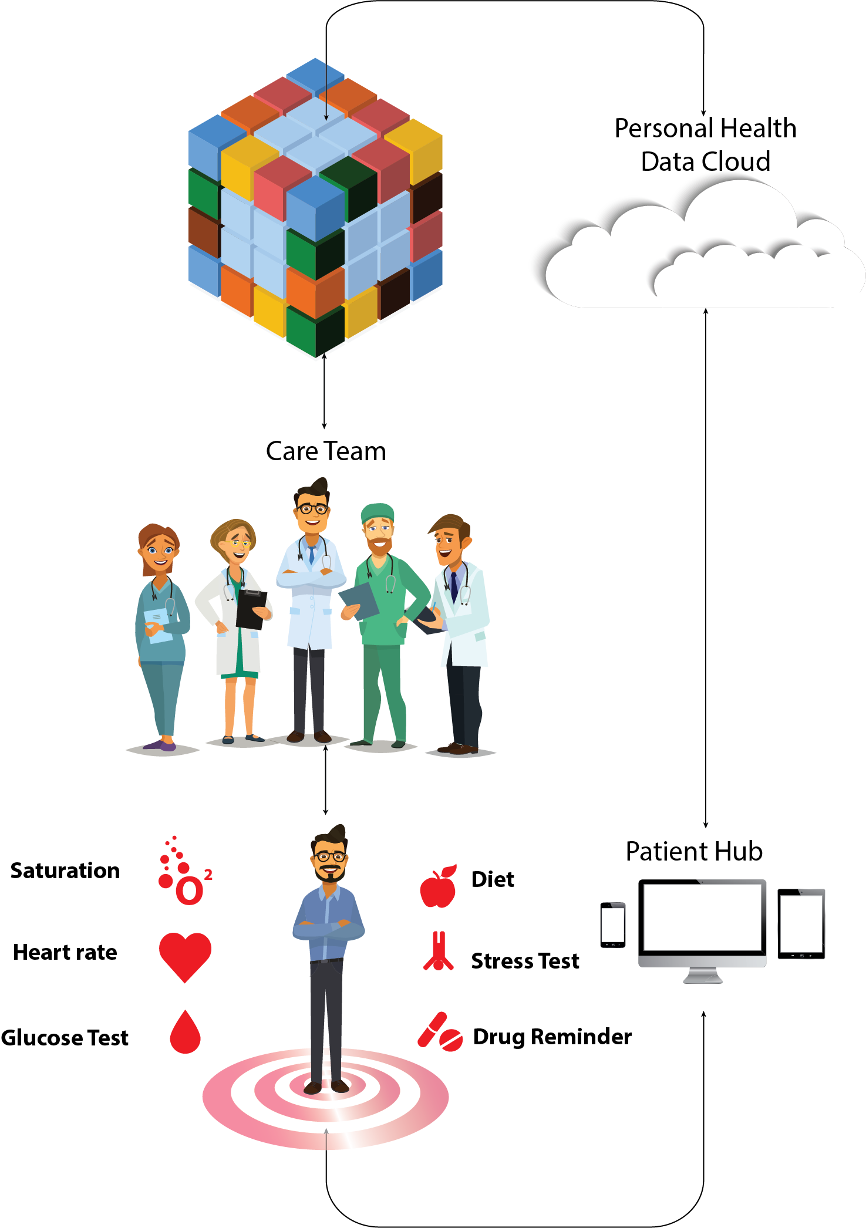

Value Creation From Mass Personalization
Value creation for individual patients at a mass scale. It makes patients the center of their own care.
Centers on cloud-based consumer access and control of personal health data
AI-enabled, digital care delivery
Source: Mark E Gilbert, Research Director Healthcare Strategy

Slide 21
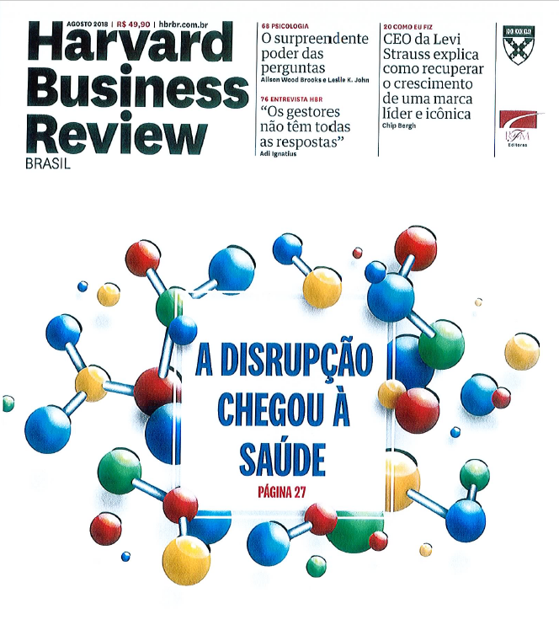
Como transformar os cuidados de saúde?
eGossistema → eCossistema
Realidade aumentada
BYOD
Health Wearables
Home Healthcheck
Patient Experience (UX) → “saída certa”
Cost Optimization
Governança Clínica
Linhas Assistenciais Estratégicas
Eficiência (leitos, suprimentos, processos)
Descobertas / Mining / Analytics / Decisão
.....

Slide 22
Referências
Patient Experience Management
Digital & IT Strategy
Discuss steps to develop a patient friendly ecosystem in the Hospital - The Future of Experience in Healthcare Demands a Consumer-Aligned, Collaborative Ecosystem
Leverage symposium replay in team lunch and learn session - Patient Engagement Strategies That Deliver on the Triple Aim
Research - Best Practices for Healthcare CIOs Driving Improved Consumer Engagement
patient data ownership and compliance aspects and on the technical barriers to patient data access - Healthcare Provider CIOs Must Translate Information Into Action by Controlling Patient Data
Research on consumer engagement and the latest technologies in the healthcare sector - Hype Cycle for Consumer Engagement With Healthcare and Wellness, 2018
Effective consumer engagement habits from other industries, apply them to healthcare - 5 Habits of Other Industries That Healthcare Can Apply to Improve Healthcare's Consumer Engagement
Research on IT Strategy - IT Strategy Template and The Art of the One-Page Strategy
Tookit - Toolkit: Recommended Action Plan for ITScore for Application Organization Assessment
Gartner Research - How to Organize IT for Efficiency and Use Business Capability Modeling to Drive Your Digital Business Design
Discuss steps to develop a patient friendly ecosystem in the Hospital - The Future of Experience in Healthcare Demands a Consumer-Aligned, Collaborative Ecosystem
Building a Digital Business Technology Platform
Digital Business Ambition: Transform or Optimize?
Digital Business KPIs: Defining and Measuring Success
How to Design Digital Business Transformation

Slide 23
Referências
Leveraging IT for Effective Healthcare Consumer, Member and Patient Engagement Primer for 2018
Developing the IT Strategy for the Real-Time Health System Primer for 2018
Developing Technology-Enabled Strategies for the Next Generation of Healthcare Primer for 2018
Leading HDOs Focus on 12 Categories of Patient Engagement Technology
Developing the Healthcare Enterprise Analytics Strategy Primer for 2018
Transitioning to Value-Based Healthcare: Building Blocks for Effective Analytics
Modernizing Healthcare Administration Systems Primer for 2018
Predicts 2017: Healthcare Providers Take a Step Toward Digital Business
Implementing and Managing EHRs, Telemedicine and Other Care Delivery IT Primer for 2018
Notes:
Myth 1: Agile, DevOps and Mode 2 are synonymous — Agile is the most common capability that organizations start with in Mode 2, and it's a great place to start because it teaches many of the principles that underpin bimodal. But agile (and other iterative methods) is equally applicable to Mode 1 initiatives. Likewise DevOps. (See "The End of the Waterfall as We Know It," G00291841). Further, we anticipate that Mode 1 will adopt many of the approaches, methods and processes for which Mode 2 acts as a trailblazer, not least iterative methods.
Myth 2: Bimodal is about speed, software development, less rigor — Bimodal is actually about the enterprise developing (or relearning) a capability to innovate and explore new opportunities, develop new products, new business models. Usually with technology, usually with software — but that's not what defines it and the software content may be a very small part. The key value proposition of Mode 2 is managing uncertainty and agility. Speed can be a powerful trait when looking to manage in an uncertain environment and create agility, but don't conflate speed and agility. But Mode 2 is not simply to plow through the application backlog faster. It's about innovating, exploring. Ultimately, Mode 2 will deliver less stuff, of greater value, faster. Mode 2 methods are designed to be exploratory. Exploring and learning about something new can require more rigor than following a well-known path. Mode 2 introduces tools that enable the enterprise to take on projects with greater uncertainties associated with them, and potentially with greater risk. To do this well requires rigor.
Myth 3: Mode 1 is static, business as usual, and is only focused on incremental continual improvements. Nothing could be further from the truth — see renovating the IT core below.
Myth 4: Mode 1 will disappear. Mode 1 as we know it today will disappear, because of the renovation described below. But organizations will always have initiatives that have low levels of uncertainty associated with them, and ones that have high uncertainty — which need managing, leading and governing differently. Things that once were uncertain will take on greater certainty and so likely transition from a Mode 2 style of work to a Mode 1 style. Other than startups, very few enterprises would be operating only in Mode 2 (for organizations that are 100% agile, see Myth 1). So Mode 1 is here to stay.

Slide 24


Slide 25

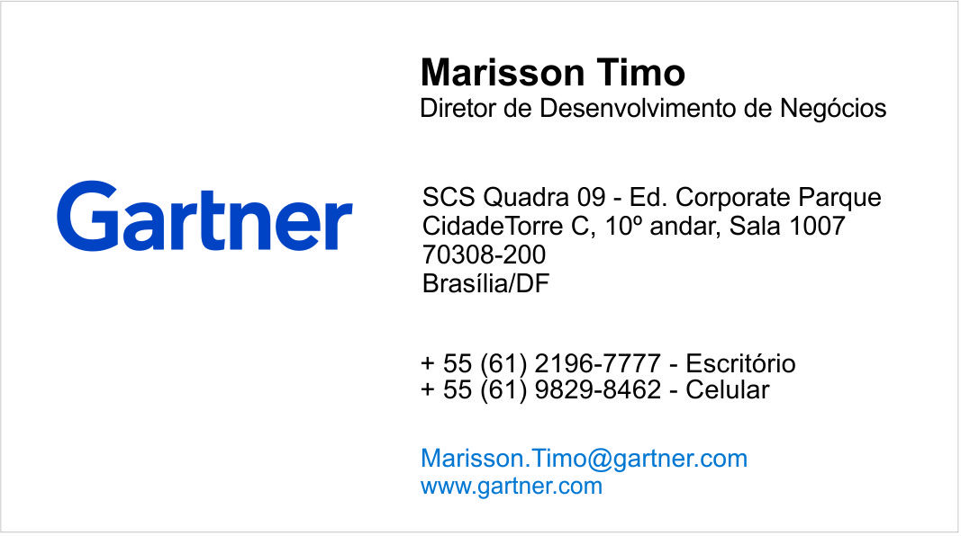
Obrigado!
Jaime Gama
Diretor de Relacionamento
+55 (71) 988024783
Jaime.gama@gartner.com
www.gartner.com
Notes:
Informação Gartner

Slide 26
Simpósio Gartner 2018 – Orlando e São Paulo
Notes:
TEMPLATE UPDATED 2 AUGUST 2018
Presenter's Name
Presenter's Name

Slide 27
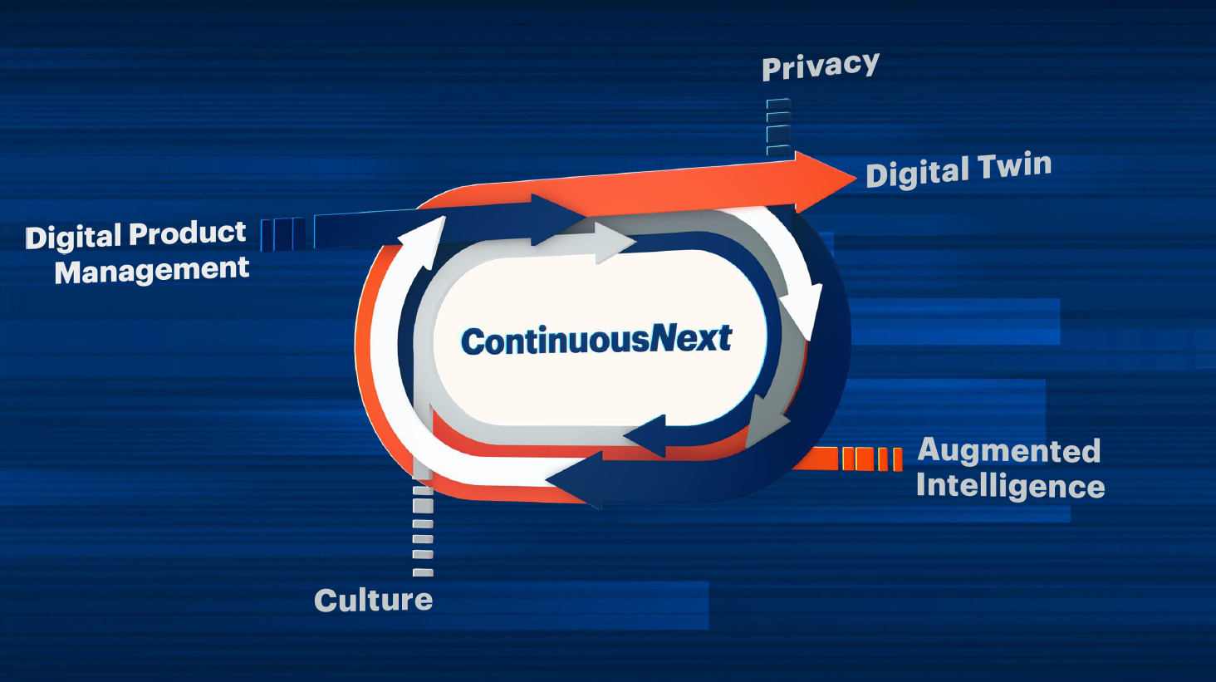

Slide 28
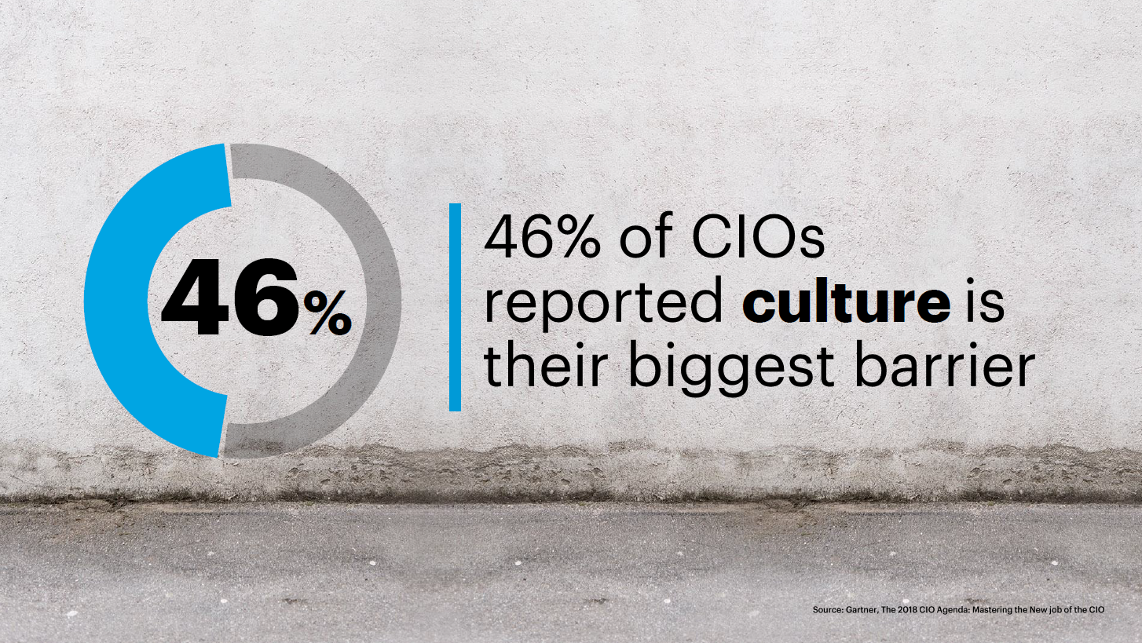

Slide 29
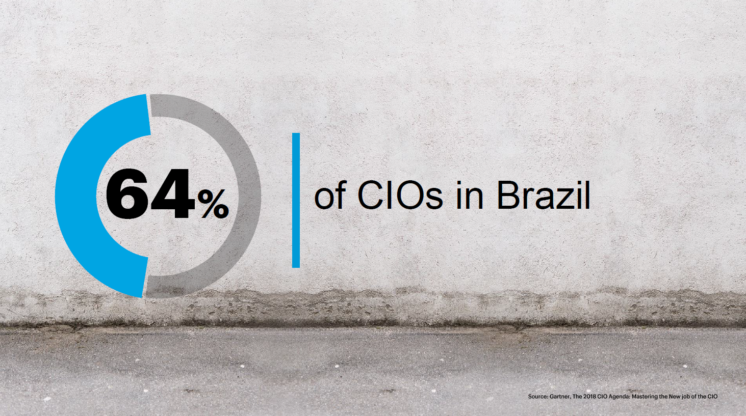

Slide 30
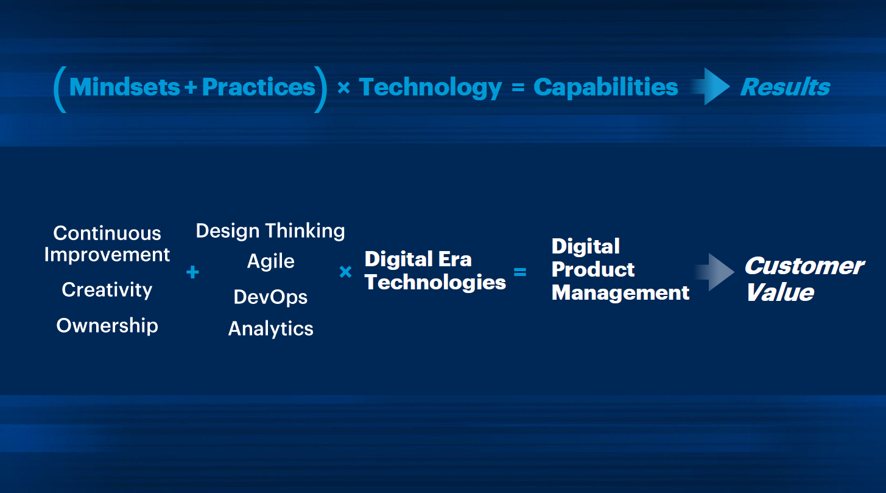
Notes:
+ = é guiado
X = é amplificado
= = Levando à novas Capacidades!
> = Gerando novos Resultados!

