Slide 1


Comprehensive Integrated Person-centered Care: Systematically Reducing Waste in Healthcare
Robert S. Janett, MD, FACP
Harvard Medical School
Cambridge Health Alliance

Slide 2


Slide 3
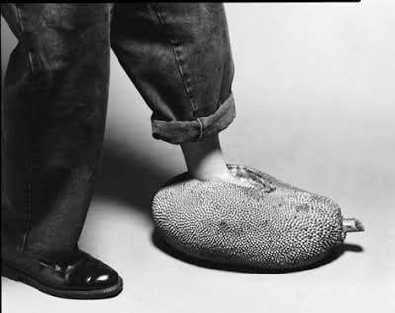

Slide 4


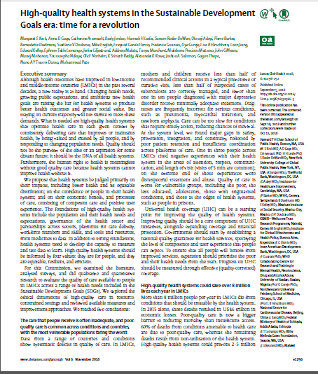

Slide 5
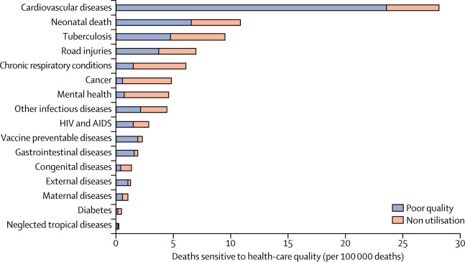

Mortality amenable to healthcare due to poor quality or non-utilization
Figure 2
Kruk, et al. The Lancet. September 2018
The Lancet DOI: (10.1016/S0140-6736(18)31668-4)
Notes:
Mortality due to poor quality versus non-utilisation of health care by condition type
Reproduced from Kruk and colleagues,³⁵ by permission of Elsevier. External factors deaths are those due to poisonings and adverse medical events. Other infectious diseases deaths are those due to malaria, diarrhoeal diseases, intestinal infections, and upper and lower respiratory infections.

Slide 6
Brazil: Quality Gaps and Deaths
Deaths amenable to healthcare | 204,036
Deaths due to poor quality | 153.327
Deaths due to non-use of services | 50.708
Percent of amenable deaths due to poor quality | 75%
Years of life lost due to poor quality | 5.966.000
Poor quality deaths | 74 per 1000 population
In 2016, over 200.000 Brazilians died because of poor care or because patients did not access necessary services

Slide 7
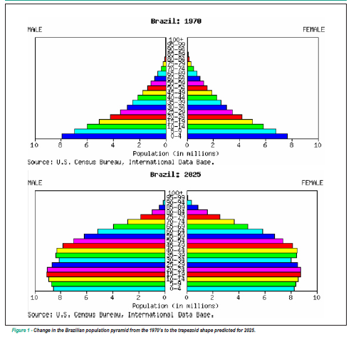

Demographic transition

Slide 8


Slide 9
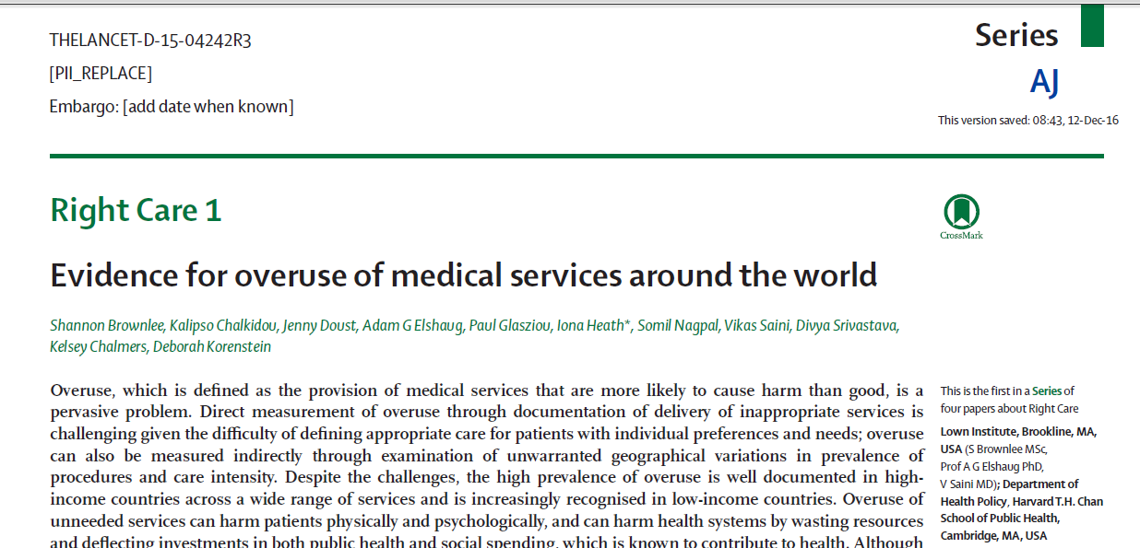
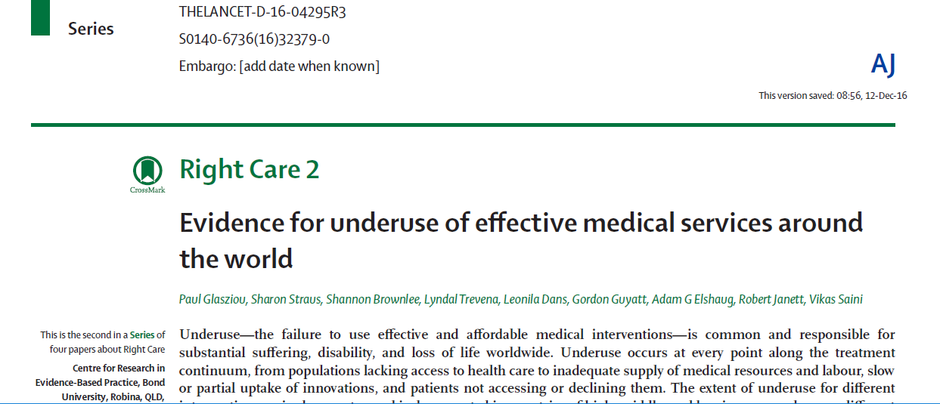

Slide 10
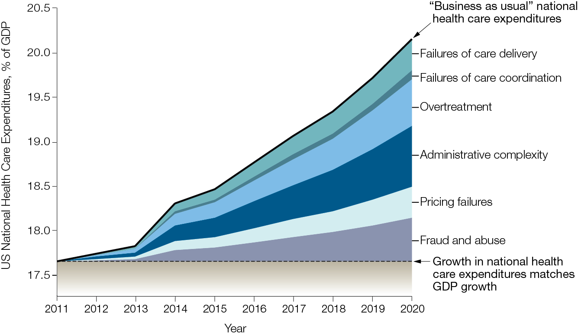
Waste in U.S. healthcare system

Slide 11
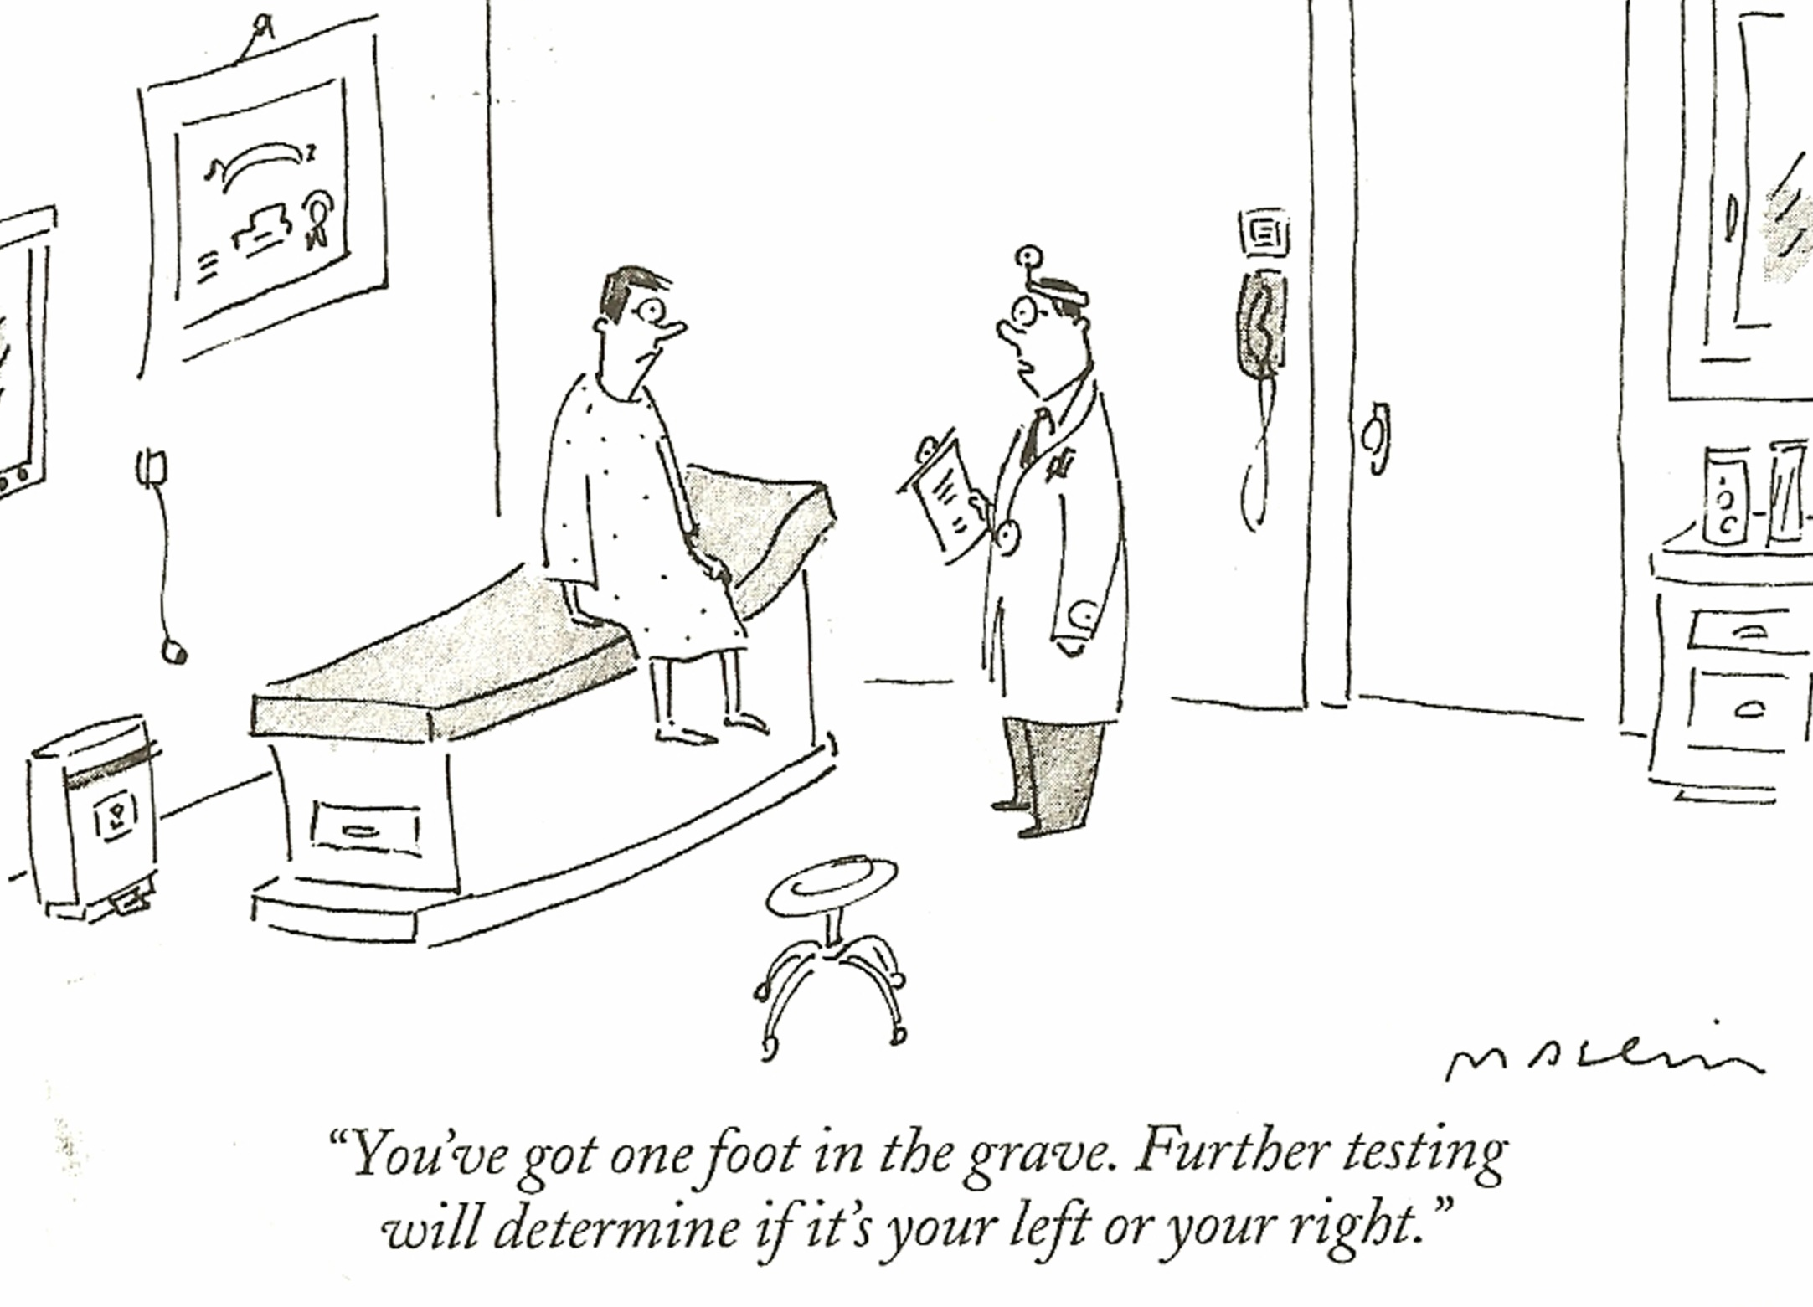

Slide 12
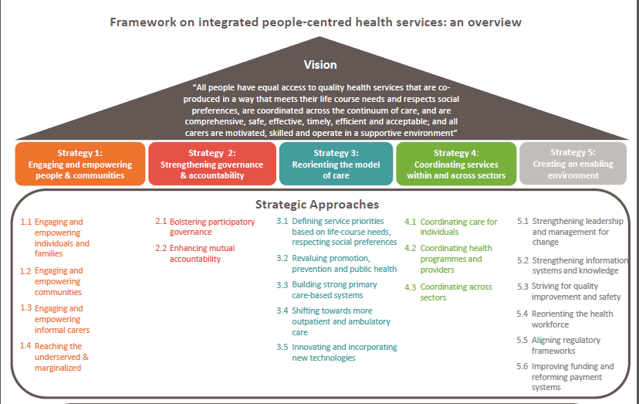
Five Strategies

Slide 13
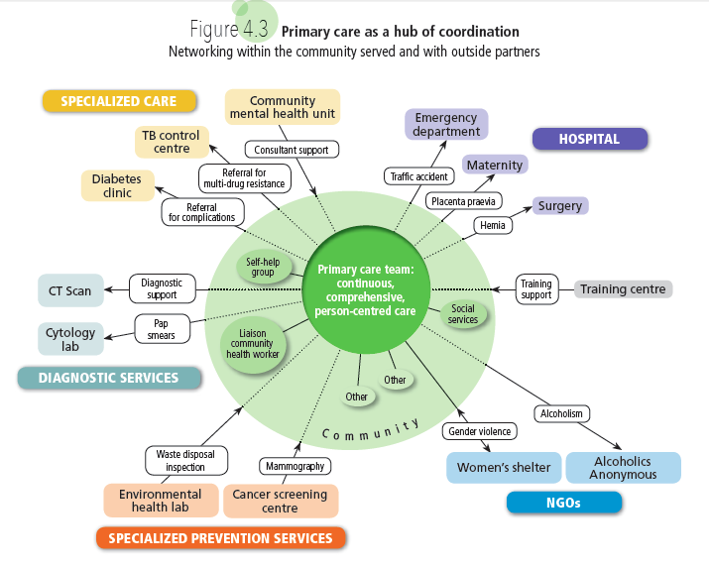

Slide 14
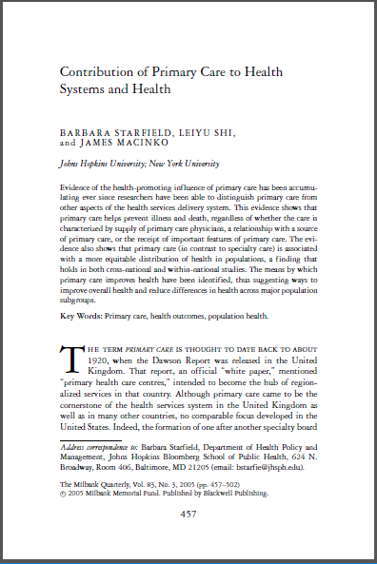
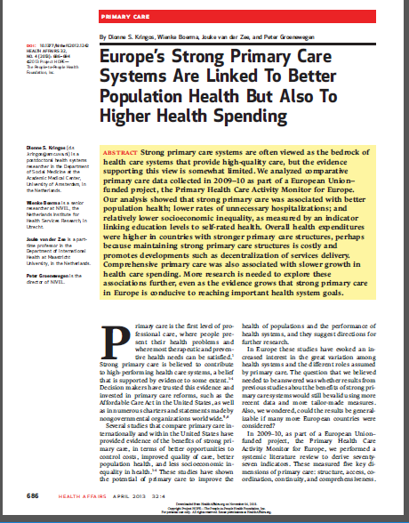
Traditional primary care: Mixed reviews

Slide 15
Unfulfilled potential of traditional primary care in Europe
Emphasis on individual-based curative care
Only those with need and motivation seek care
Inadequate focus on social determinants of health
Exacerbated by the separation of primary care delivery from public health functions
FFS payment systems
Notes:
Move beyond FFS
Empanelment
Cultural shift to support and value preventive care

Slide 16
The case
Large premalignant adenomatous polyp found in 2002. Close follow up advised.
No further colon cancer screen in five years
Malignant entero-cutaneous fistula in 2007
Multiple hospitalizations, XRT, long rehab stay, colostomy, family angst, pain and suffering, disability, & cost.

Slide 17
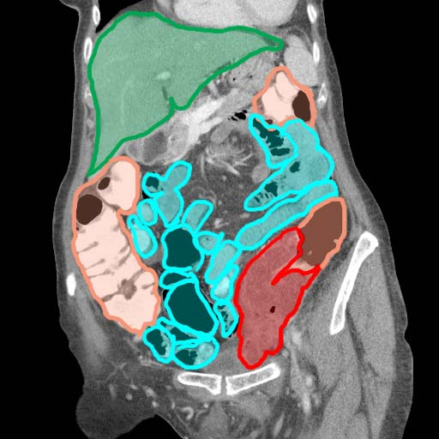
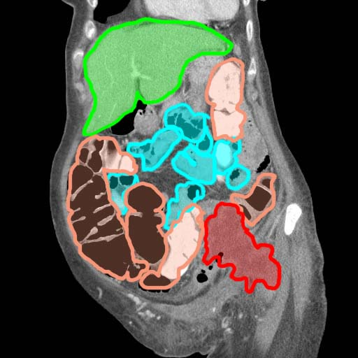
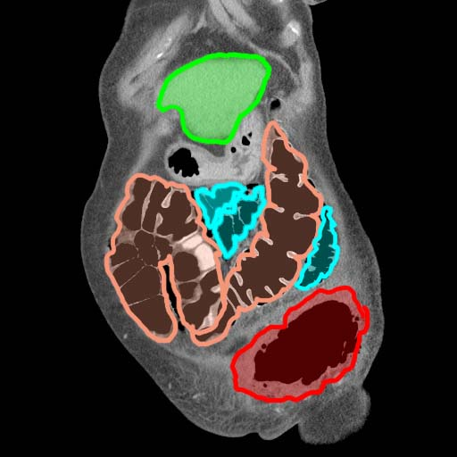

Slide 18
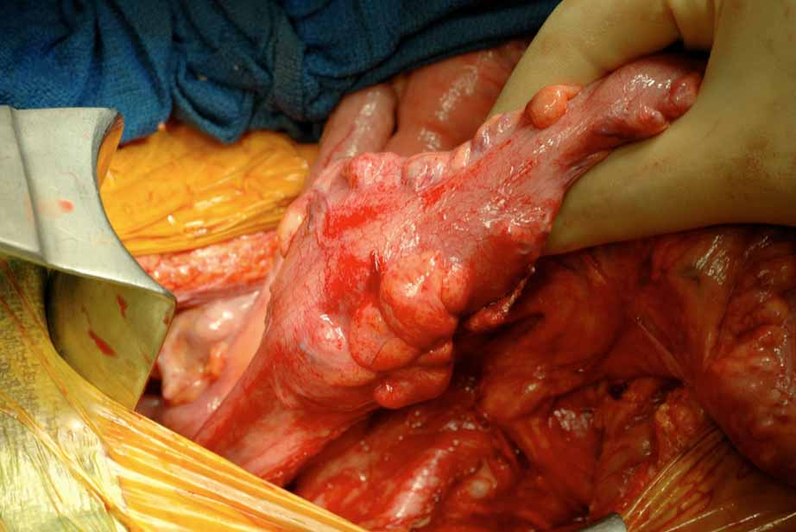

Slide 19
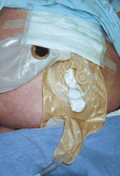

Slide 20


Slide 21
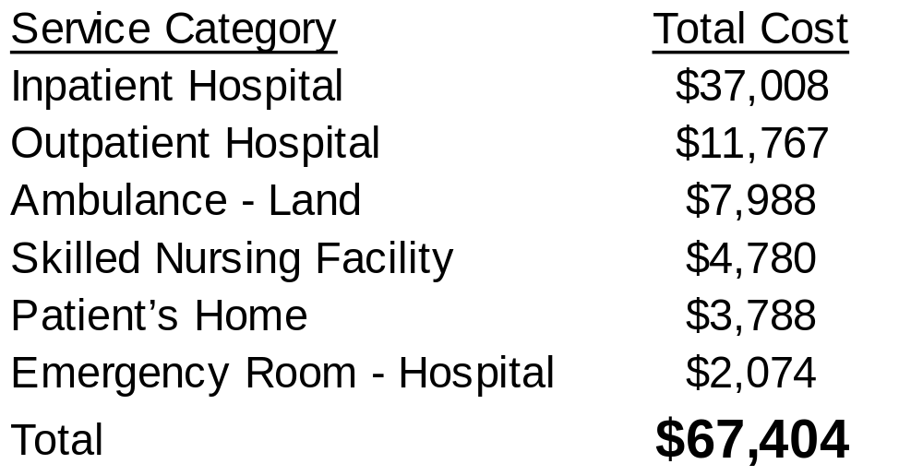
Actual Costs of Medical Treatment
vs. costs of:
Colonoscopy with biopsy = $962
Colectomy = ~$5600

Slide 22

Gaps

Slide 23
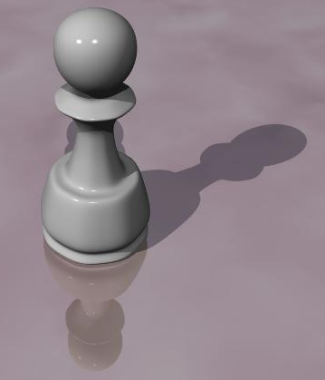


Slide 24


Slide 25
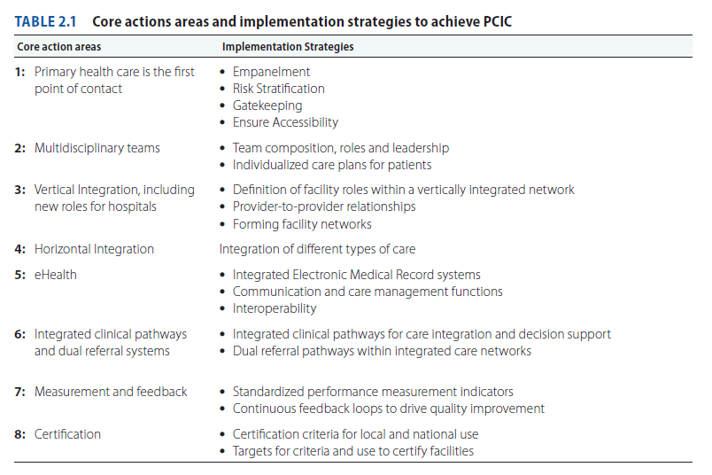
Strategies to implement PCIC

Slide 26
Reliability in the delivery model
The Planned Care model
Teamwork
The magic of the checklist and the spread sheet
Reminders to providers and reminders to patients
Outreach
Communication, integration with diagnostics, specialists and hospitals, and managed hand-offs

Slide 27
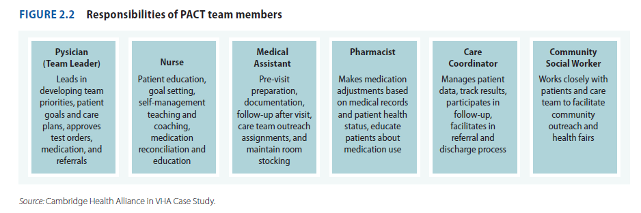
Multidisciplinary teams

Slide 28
Panel
Chronic Conditions
Seeing you
today

Slide 29
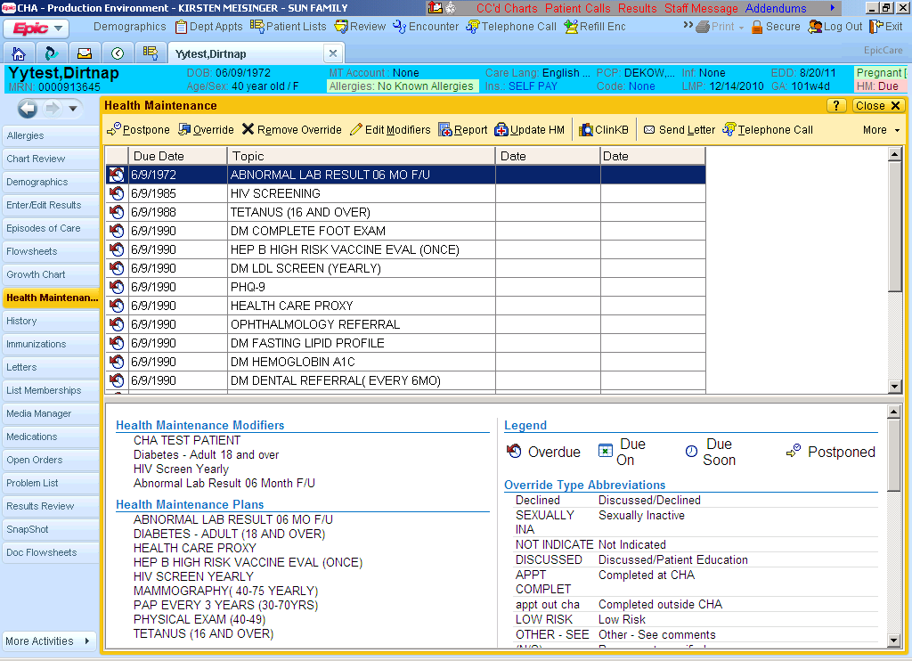

Slide 30
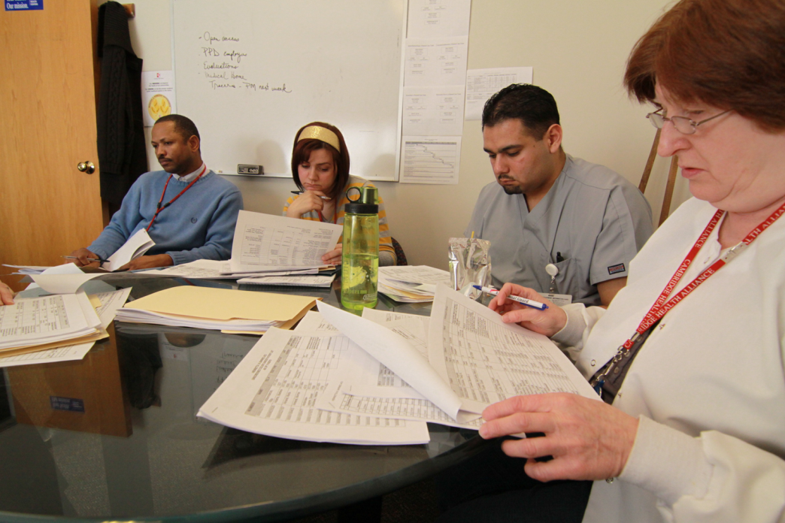
Planned care
Manage chronic and intensive conditions
Avoid secondary complications of the underlying chronic disease
Reliably deliver needed services to close gaps in care

Slide 31
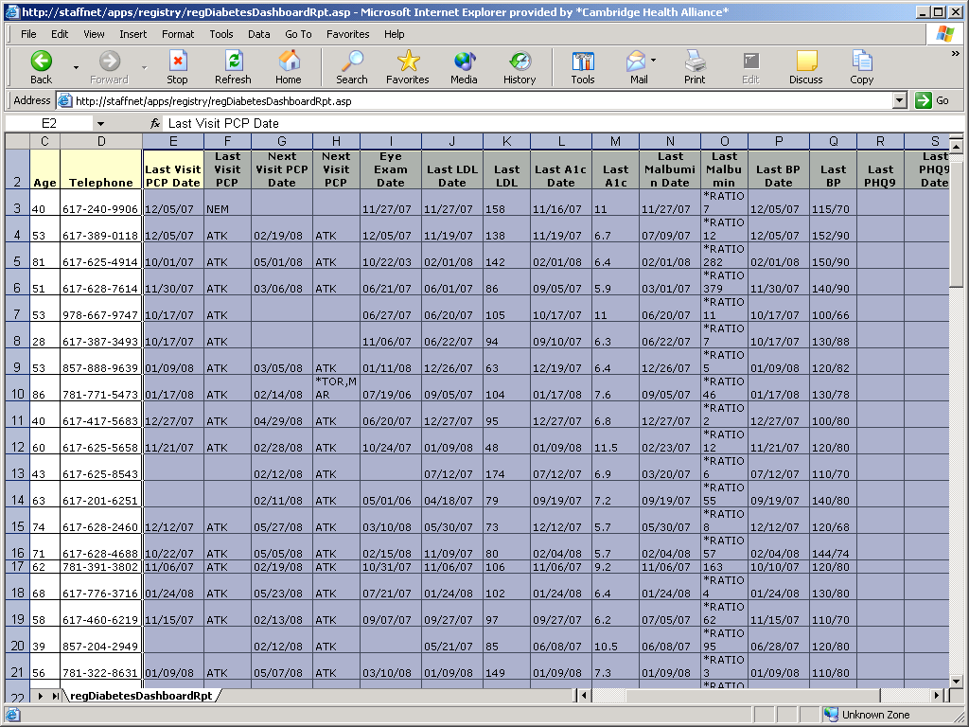

Slide 32
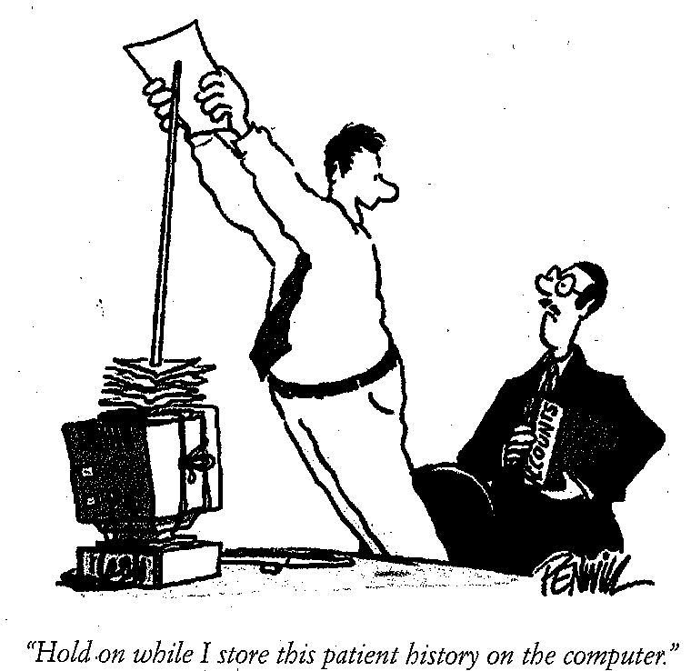

Slide 33
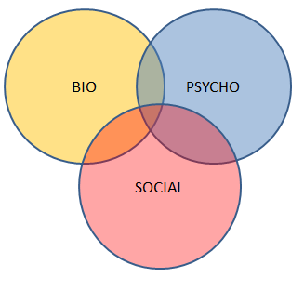


Slide 34
Comprehensive integrated primary care
Better access and availability
    Telephone and Internet access
    Next-day appointment access
Better coordination
  Managing transitions of care
    Integration with hospitals and specialists
    Informing specialists and hospitals of medical information and patient history at the time of referral
    Specialists and hospitals share information with primary care team
Better tracking of patients who are fragile or complex
Multidisciplinary teams
Relentlessly embedding quality improvement activities in the daily operations of the clinic

Slide 35
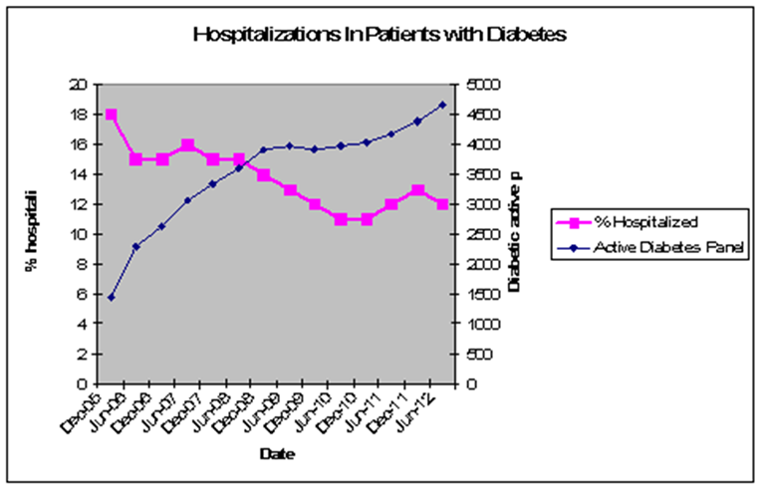
Results
Sharply improved quality metrics for chronic disease and preventive screening
Reduce the need for hospital care
Cost savings
Beneficial impact on integrated network revenue in a capitation model

Slide 36


Slide 37



Slide 38
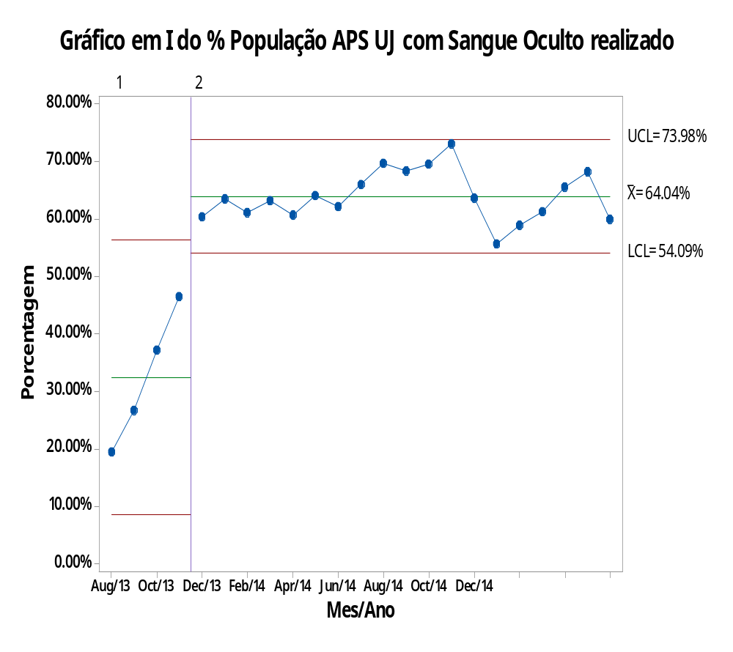

Dramatic improvement in cancer screening
Rastreio de Neoplasias

Slide 39
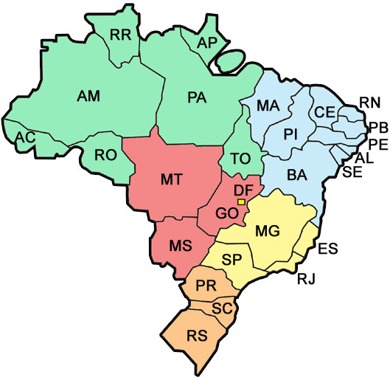
Unimed Guarulhos
Unimed Guarulhos (1994)
86,000 clients
246 cooperative doctors
Notes:
Back to Brazil all cooperatives were induced to start PC pilots, and one of the pioneers was the Unimed Guarulhos.
Unimed Guarulhos, is a private Health Insurance Company in Guarulhos, a city in Sao Paulo. It was founded in 1994. Today, this company has 246 specialists and provides care for 90,000 clients. Unimaginable, isn’t it? So many specialists for so few people…
From the beginning, the cooperative had only specialists and no primary care physicians, collecting the same bad results.
In 2012, Unimed Guarulhos made part of the first wave of changing

Slide 40




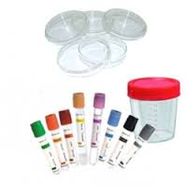





Provider Perspective
PSYCHOLOGIST
ENDOCRINOLOGIST
OPHTHALMOLOGIST
NEPHROLOGIST
DIAGNOSTIC CENTER
DIABETES MELLITUS PATIENT
HOSPITAL ADMISSION
ER
SOCIAL WORKER
NUTRITIONIST
CARDIOLOGIST
Notes:
For Unimed Guarulhos, everything was ok. That was the scenario from the Unimed Guarulhos point of view and its cooperative professionals’ point of view. We provided a good structure with hospitals, doctor’s offices, excellent professionals and all the care services the patients needed at their disposal.

Slide 41


Patient’s Experience = a CHAOTIC scenario
PSYCHOLOGIST
ENDOCRINOLOGIST
OPHTHALMOLOGIST
NEPHROLOGIST
DIAGNOSTIC CENTER
DIABETES MELLITUS PATIENT
HOSPITAL ADMISSION
A&E
SOCIAL WORKER
NUTRITIONIST
CARDIOLOGIST
Notes:
However, this was the patients’ point of view of the process: a chaotic scenario. Despite the structure Unimed Guarulhos offered, the patient were completely lost in this system.
There were problems to be solved.

Slide 42
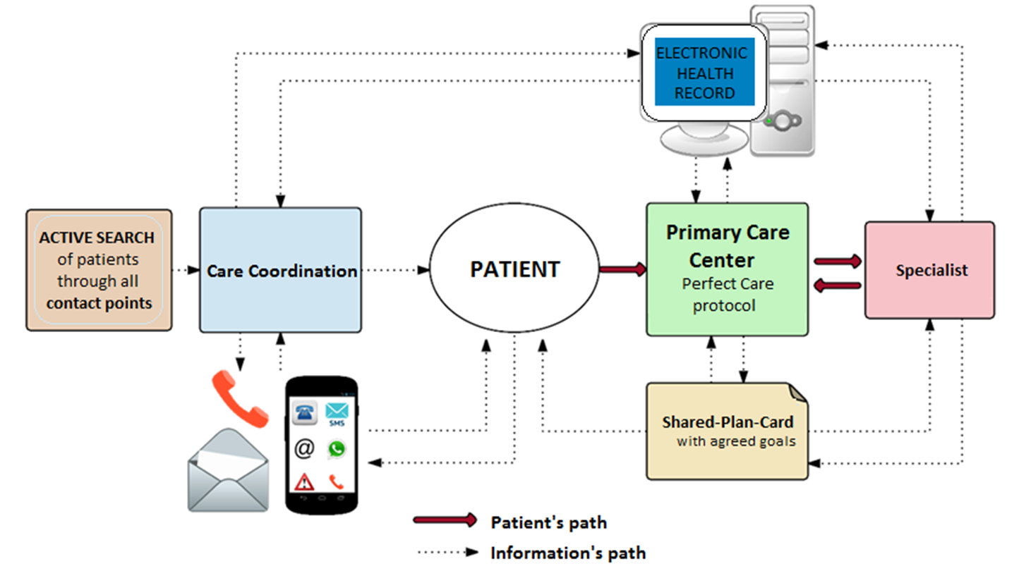
The new model
Notes:
And this is the new model: simpler and more convenient for patients.
The patient in the core of the system with a shorter path for them to follow.
The Primary Care Center is responsible to ensure the Perfect Care protocol.
And all theses information’s path helping the care coordination.
In this new model, if the patient forgets to return to do tests, It is not just their problem. Now it's our problem too.
We use reminders and Active search for patients through all contact points in the system.
But how we will know that these changes are an improvement?

Slide 43
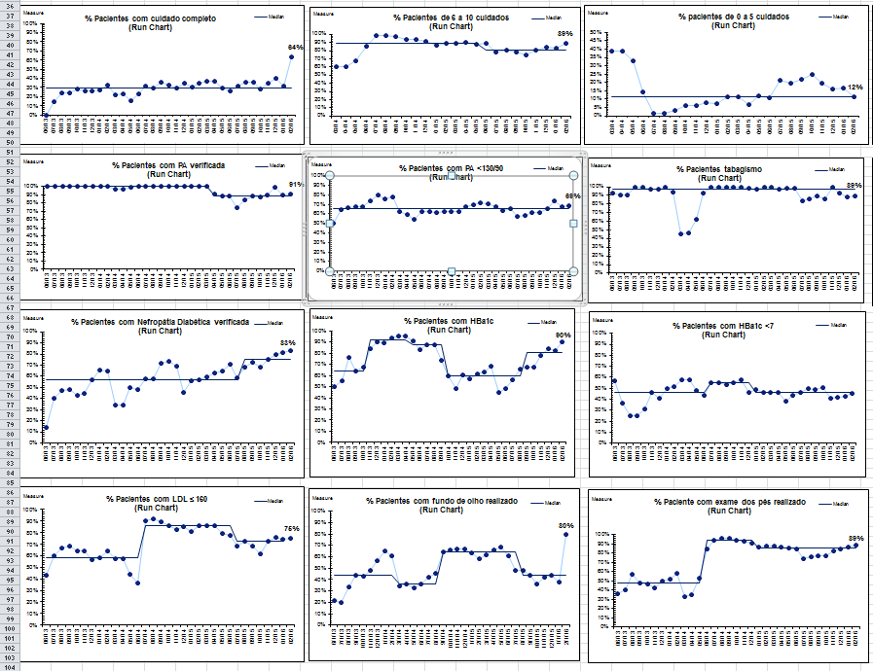
A family of processes and outcome measures have been reported monthly
Notes:
Through colected data and
Through Routine analyses and publication of data,
In this project, a family of processes, balancing and outcome measures have been reported monthly.
Now, I would like to highlight some of the main measures.

Slide 44
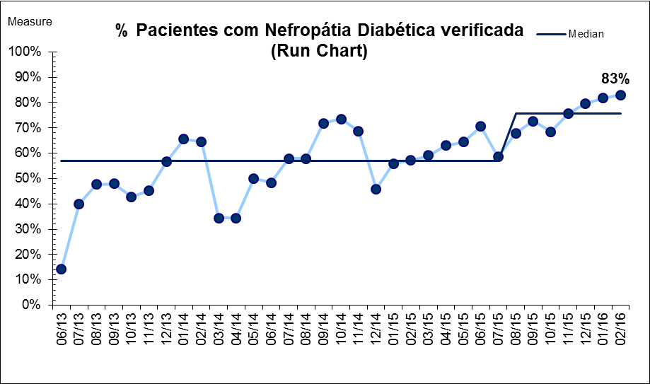
Patients with searching for nephropathy improved from 14% to 83%
% Patients with searching for nephropathy
Notes:
Now, let’s take a look at this graph: it shows that the % of patients with searching for nephropathy
improved from 14% to 83%

Slide 45
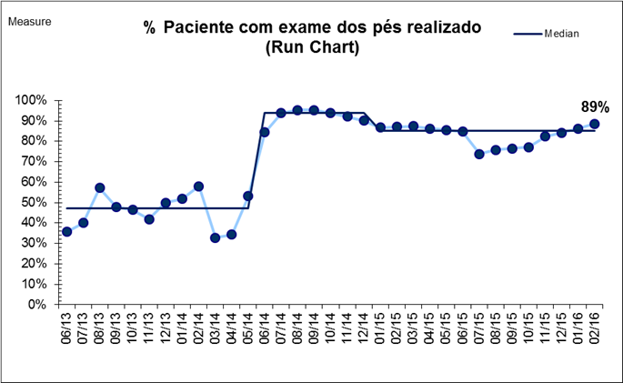
Percentage of patients with annual foot exam improved from 36% to 89%
% Patients annual foot exam
Notes:
Detection of diabetic foot complications is key to amputation prevention.

Slide 46
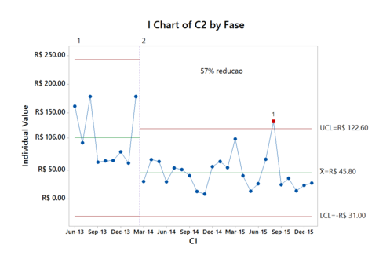
ER per capita costs: decreased 57%
Notes:
And here the graph shows that the ER per capita costs: decreased 57% throughtout the project.

Slide 47
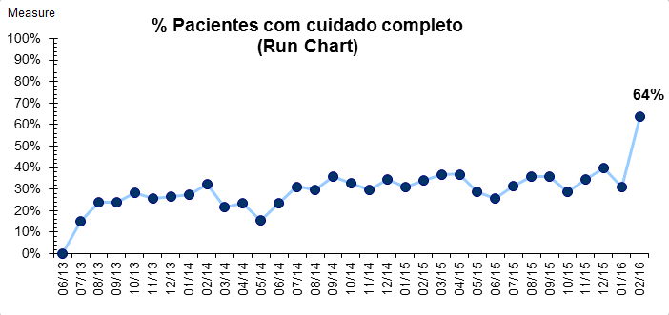
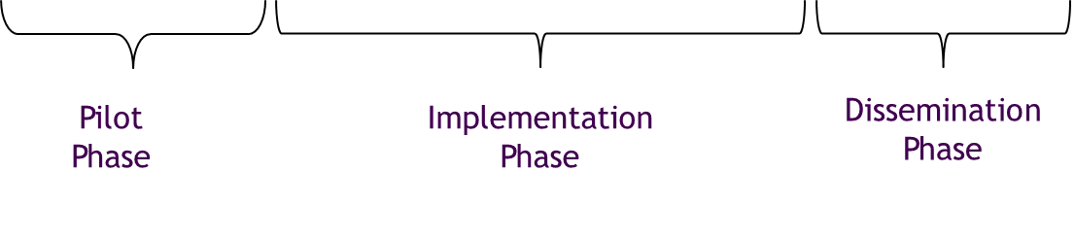
Percentage of patients with Perfect Care improved from 0% to 64%
% Patients with Perfect Care
Notes:
And finally this is the main graph: the percentage of patients with the Perfect Care increased from 0% and it has maintained between 30% and 40
On february 2016, there was a sharp because we improved data collection: now we are considering the retinal mapping as eye exam too.

Slide 48
What does our Brazilian experience tell us?
The marked improvement in cost and quality is found across a wide geography and in a variety of clinic types and sizes
These outcomes are NOT the result of heroic efforts of individuals
Improvement in performance is a systems property of the primary care model when applied to the patients in the Brazilian Saúde Suplementar

Slide 49
Solutions
Truly comprehensive integrated primary care centered on the patient’s values and needs
  Be careful. There is a lot of ‘fake news’ right now regarding primary care in Brazil.
Integrated with specialists, hospitals and diagnostic centers
Shared information, patient registries, protocols and checklists
New roles for hospitals to assure vertical integration with community-based providers

Slide 50
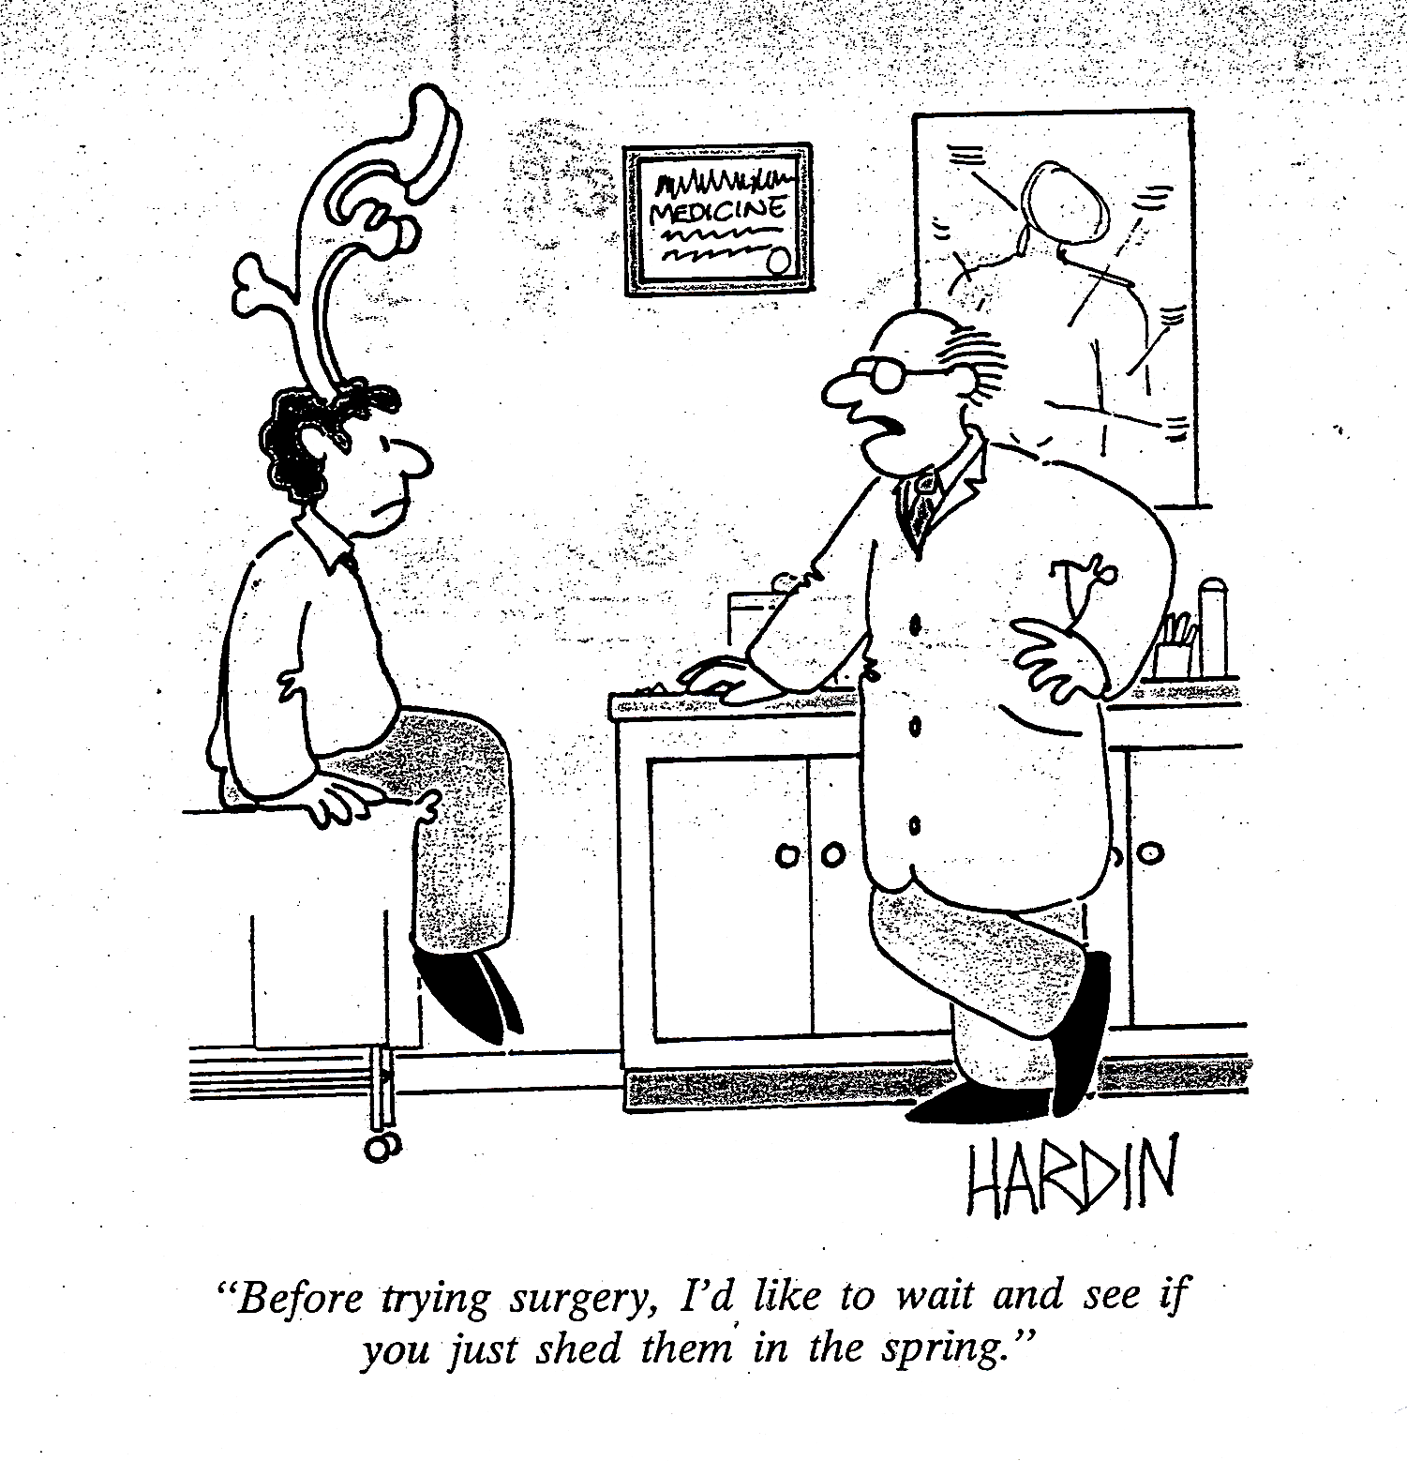

Slide 51
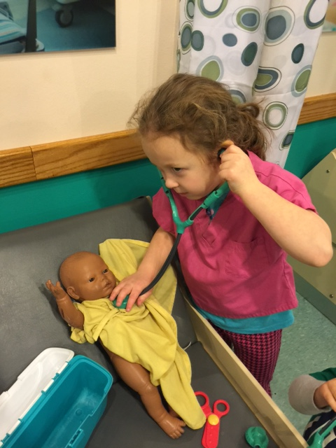

Slide 52
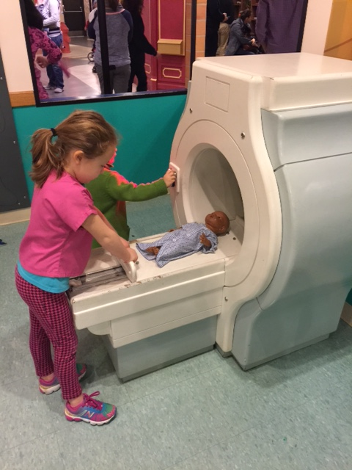

Slide 53


