Slide 1
Value-Based Health Care
Conahp
Parashar Patel
November 7, 2018

Slide 2
What is Value Based Healthcare?
Health outcomes that matter to patients
Value =
Cost of delivering these outcomes
… over the full cycle of care
Fee For Service (FFS) Focus
Value Based Health Care (VBHC) Focus
Procedure Results
Outcomes that Matter
to Patients
Acute Care / Transactional
Longitudinal
Payer Cost for Procedure
Total Payer Cost

Slide 3
Alternative payment models (APMs):
Driving shift to VBHC
Category 1
Fee for service
(FFS)
  Contracts based on volume/ activity units
  No link to quality & value

Slide 4
Category 1: Prospective Payment Systems
Prospective Payment Systems (PPS)
Payment is made based on a predetermined, fixed amount based on type of service delivered, diagnosis, and other combination of factors
Grouping System
Relative Weights
Conversion Factor/ Standardized Amount
Geographic Cost Adjustments
Additional Adjustment Variables
Payment Amount
*Updated regularly (annually in the US) to adjust for new information (relative weights, volume), inflation
For providers: simplified, predictable payment system that rewards efficiency.
For payers: control growth of spending.

Slide 5
Alternative payment models (APMs):
Driving shift to VBHC
Category 1
Category 2
Fee for service
(FFS)
Fee for service Linked to Quality
  Contracts based on volume/ activity units
  No link to quality & value
  Pay-for-performance using FFS
  Link to quality & value (e.g., 30-day readmission penalties)

Slide 6
Long History of Medicare Quality Initiatives…
Hospital Acquired Conditions: Penality; cases not assigned to higher paying DRG if certain conditions acquired during hospital stay
Premier Hospital Demo: Incentive payments for attainment and improvement (FY04-FY09)
Hospital Inpatient Data Reporting: Voluntary reporting of quality data
12:00 am
Inpatient Pay-for-Reporting: Penalty: update reduced by 0.4% (FY05-FY06)
Outpatient Pay-for-Reporting: Penalty; update is reduced by 2% (09+)
11:59 pm
Inpatient Pay-for-Reporting: Penalty increased to 2% (FY07+)
12:00 am
12:00 am
12:00 am
11:59 pm
2003
2003
2004
2005
2006
2007
2008
2009
2010
2010
Today
Physician Group Practice Demo: Performance payments up to 80% of cost savings based in part on quality improvement (05-10)
12:00 am
Physician Quality Reporting Initiative (PQRI): Voluntary; bonus of up to 1.5% of charges subject to a cap (07-08)
12:00 am
Physician Compare Launched: Includes data on specialty, location, and satisfactory reporting under PQRI
11:59 pm
PQRI: Bonus increased to 2% of charges (09-10)
11:59 pm
Physician Resource Use and Measurement Reporting Program (RUR) Phase I: Reports sent to providers in 12 metro areas
11:59 pm
Hospital
Physician

Slide 7
… and driving shift to Category Two.
Hospital Value Based Purchasing (VBP) Program: Incentive payments funded through a 1% reduction in all DRG payments
RRP: Penalty increased to 3% for FY15+, COPD and hip/knee added
Hospital Readmission Reduction Program (RRP): Penalty; reduction of up to 1% of base payment for higher than expected readmissions for 3 conditions (AMI, HF, PN) (FY13)
Hospital Acquired Conditions (HAC) Payment Adjustment: Penalty; base DRG payments reduced by 1% for hospitals in bottom quartile (FY15+)
RRP: Added CABG
Oct 1
VBP: Penalty increased to 2% (FY17+)
Oct 1
Oct 3
2011
2012
2013
2014
2015
2016
Oct 1
2017
2018
2019
Physician Feedback Program: CMS begins providing reports comparing physician resource use using episode groupers
Oct 1
Oct 2
Value-Based Payment Modifier: Applied to all physicians
Quality Payment Program (QPP): MIPS (FY19+)
2011
2019
Jan 1
Mandatory Physician Quality Reporting: Penalty increases to 2% of Medicare payments
Jan 1
Today
Jan 2
PQRI: Bonus reduced to 0.5% of charges (FY12-FY14)
Mandatory Physician Quality Reporting: Penalty, 1.5% reduction in Medicare payments
Jan 2
RUR (Phase II): Reports to include clinical quality data (FY11/FY12)
Jan 1
Value-Based Payment Modifier: Applied to specific physicians as determined by the Secretary
Jan 1
PQRI: Bonus reduced to 1% of charges
Jan 1
Hospital
Jan 1
Jan 1
Physician

Slide 8
Alternative payment models (APMs):
Driving shift to VBHC
Category 1
Category 2
Category 3
Category 4
Fee for service
(FFS)
Fee for service Linked to Quality
Episode-based
incentives
Population
health
  Contracts based on volume/ activity units
  No link to quality & value
  Pay-for-performance using FFS
  Link to quality & value (e.g., 30-day readmission penalties)
  APMs built on FFS
  Bundled payment of fixed amount (e.g., hip replacement)
  Accountable care organizations
  Provider incentivized to reduce payer’s cost of care

Slide 9
Health Reform Drives Shift to Categories Three & Four
BPCI Advanced: test a new iteration of bundled payments for 32 Clinical Episodes
Pioneer ACOs: ACO program for "advanced" physicians/hospital groups
Bundled Payments for Care Improvement (BPCI) Initiative: Pilot program to test bundled payments (MD & hospital) using 4 payment models
Comprehensive Care for Joint Replacement (CJR) Model: Mandatory bundled payments for hip/knee
Proposed "Pathways to Success" two-sided ACO models would start
Oct 1
Shared Savings Program: First year of shared savings (ACO) program
Oct 1
Jan 1
Mar 1
Mandatory Bundled Payments: Cardiac episodes cancelled
Jul 1
Oct 1
Jan 1
2011
2011
2012
2013
2014
2015
2016
2017
2018
2019
2019
Bundled Payments for Care Improvement (BPCI) Initiative: Pilot program to test bundled payments (MD & hospital) using 4 payment models
Jan 1
Oct 1
Today
BPCI Advanced: test a new iteration of bundled payments for 32 Clinical Episodes
Proposed "Pathways to Success" two-sided ACO models would start
Jul 1
Shared Savings Program: First year of shared savings (ACO) program
Oct 1
Quality Payment Program (QPP): Advanced APMs (FY19+)
Jan 1
Pioneer ACOs: ACO program for "advanced" physicians/hospital groups
Oct 1
Hospital
Physician

Slide 10
Alternative payment models (APMs):
Driving shift to VBHC
Category 1
Category 2
Category 3
Category 4
Fee for service
(FFS)
Fee for service Linked to Quality
Episode-based
incentives
Population
health
  Contracts based on volume/ activity units
  No link to quality & value
  Pay-for-performance using FFS
  Link to quality & value (e.g., 30-day readmission penalties)
  APMs built on FFS
  Bundled payment of fixed amount (e.g., hip replacement)
  Accountable care organizations
  Provider incentivized to reduce payer’s cost of care
Today
  ~5-10%
  ~50-75%
  ~15-25%
  ~5-10%
In 4 years
  ~5-10%
  ~40-55%
  ~20-30%
  ~15-25%
Volume focused
Change is gradual; ~80% of models will continue to reward volume but all focused on outcomes & value to some extent
Source: Estimates triangulated based on BSC survey of hospital executives; Healthcare Learning and Action Network study; McKesson Health Solutions, "The State of Value-Based Reimbursement and the Transition from Volume to Value in 2016"

Slide 11
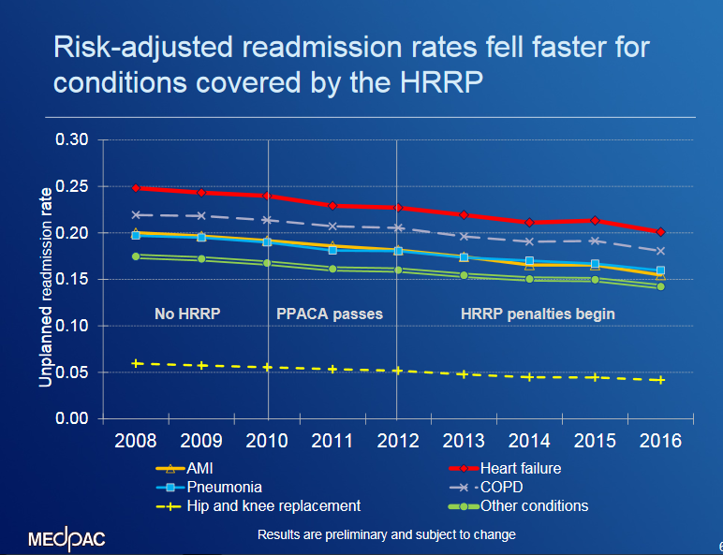
Hospital Readmission Reduction Program:
MedPAC Perspective
17% reduction in readmissions per capita
Greater use of observation beds and ED only slightly correlated with lower readmission rates
$2 billion per year saved, not counting penalties
No negative impact on mortality
Readmission Reduction Program working…refine penalties and expand.

Slide 12
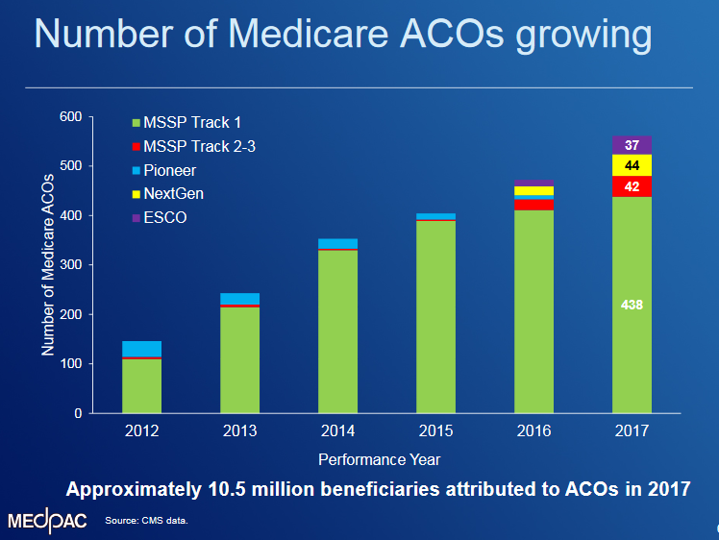
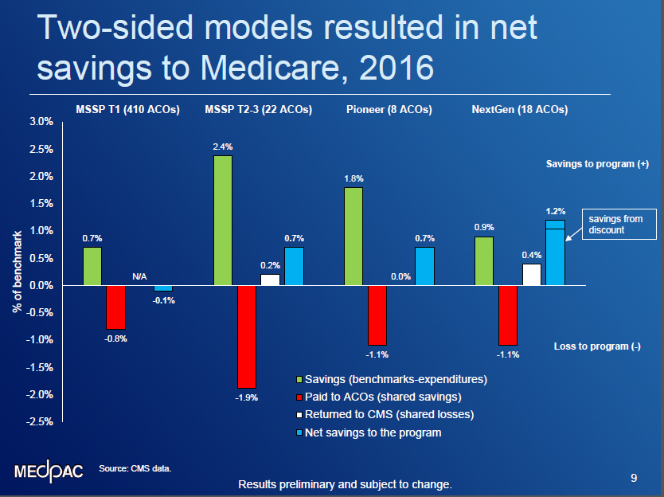
Medicare Shared Savings Program:
MedPAC Perspective
Two-sided risk generates more savings; many policy questions to optimize program.

Slide 13



Barriers to Faster Adoption of APMs
Legal and Regulatory Policy
Operational and Data Access
Financial Alignment and Payment Innovation

Slide 14






Health systems operating under multiple payment models
Conventional
(no provider / payer alignment)
Transitional
(some level of alignment)
Fully aligned
(full alignment)
Episode-based & share risk
FFS Linked to Quality
Customer archetype
Netherlands
Success factors
    Attract private payers
    Attract high-reimbursement, specialty procedures
  Attract private
  pay patients
  Experiment with VB bundles (Walmart)
  Offer end-to-end, integrated care
  Trade-off outcomes
  vs. cost over longer
  time horizon

Slide 15




Shift to VBHC impacts all stakeholders
PATIENT
PAYER / EMPLOYER
PROVIDER
SUPPLIER
Short term & Long term
Private: 2–3 yrs Med Adv: 7–8 yrs
Annual +
-----
Time
horizon
Outcomes-focused
Cost-focused
Provider alignment to reduce costs
Data/analytics to monitor and intervene
Increased tracking of outcomes
and costs
Reduce unnecessary procedures
Integrate care delivery
Upside with robust VBHC value props
Lower procedure volume
Higher bar to demonstrate value prop

Slide 16
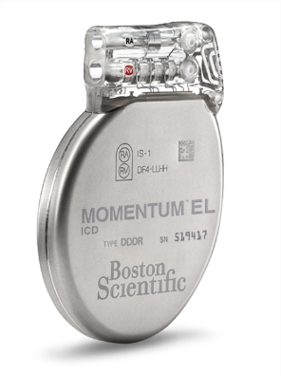
Value-based Arrangements:
ICDs?
Category 1
Category 2
Category 3
Category 4
Fee for service
(FFS)
Fee for service Linked to Quality
Episode-based
incentives
Population
health
Hospital and MD paid at implant
Mfgr. paid for ICD before/after implant
Hospital and MD paid at implant, adjusted based on “quality” metric(s)
Mfgr. paid for ICD before/after implant
Hospital paid bundle for all services for 90-days post-implant; responsible for distributing payment to MD and other providers; must meet quality metrics
Periodic payments for ICD on subscription basis for duration of “episode” – until replacement or death
Health systems paid to reduce and maintain incidence of sudden cardiac arrest below agreed levels.
Payment based on size of population and risk-adjusted.
Mfgr. paid for devices after implant and responsible for px-related device costs w/in 90 days of implant
What are implications for primary prevention use?
Are ICDs appropriate candidates for value-based arrangements?

Slide 17

Value-based Arrangements:
WATCHMAN?
Category 1
Category 2
Category 3
Category 4
Fee for service
(FFS)
Fee for service Linked to Quality
Episode-based
incentives
Population
health
Hospital and MD paid at implant
Mfgr. paid for WATCHMAN before/after implant
Hospital and MD paid at implant, adjusted based on “quality” metric(s)
Mfgr. paid for WATCHMAN before/after implant
Hospital paid bundle for all services for 90-days post-implant; responsible for distributing payment to MD and other providers; must meet quality metrics
Mfgr. paid before/after implant and agrees to return certain amount if certain percentage of patients have stroke within 1-year of implant
Health systems paid to reduce and maintain incidence of sudden cardiac arrest below agreed levels.
Payment based on size of population and risk-adjusted.
Mfgr. receives pre-determined fixed amount to provide WATCHMAN to all patients within a given time period
What are implications for patients?
Is WATCHMAN an appropriate candidate for value-based arrangements?

Slide 18
Closing Thoughts
Health outcomes that matter to patients
Value =
Cost of delivering these outcomes
… over the full cycle of care
FFS Focus
VBHC Focus
Procedure Results
Outcomes that Matter
to Patients
Acute Care / Transactional
Longitudinal
Payer Cost for Procedure
Total Payer Cost

Slide 19
Obrigado

