Slide 1
Healthy Returns
Global Trends & Universal Health Coverage
Mark Britnell
—
Global Chairman & Senior Partner, Healthcare, Government & Infrastructure, KPMG International
@markbritnell

Slide 2

Member of the World Economic Forum Global Health Council
77
countries worked in
330+
occasions

Slide 3
Our global healthcare network
Healthcare systems around the world are facing unprecedented challenges.
With deep industry experience, KPMG member firms are uniquely positioned to provide guidance and support.
We help them to successfully navigate this rapidly changing environment to transform the way that Healthcare is provided.
45
4,500+
Equipped and experienced advisory teams across the global network
KPMG country
health practices
KPMG Partners and staff work in healthcare

Slide 4





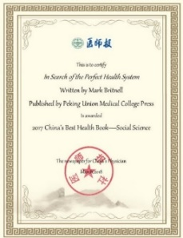

Slide 5

PPPs and UHC: A rising trend
For the private sector, there is appeal in emerging health systems growing at several times those of the West
C
E
A
D
B
A
B
C
D
E
$3.2 trillion
+4.6% p/a
$0.5 trillion
+6% p/a
$2.2 trillion
+3% p/a
$0.2 trillion
+8% p/a
$1.6 trillion
+10% p/a

Slide 6

The triple win
Ideally, a successful PPP achieves a ‘triple win’ for all involved, whereby:
Government is awarded a project or service which is completed at a lower cost and higher quality.
Public have access to healthcare that they would not have normally been able to afford.
Through autonomy, private sector partners can deliver future proof service as well as make a return on investment.

Slide 7

Benefits for Governments
1
2
Bring new innovations and ideas into the provision of services
Limit the seemingly ‘bottomless pit’ of healthcare’s potential costs to government
For governments pursuing UHC, PPPs offer 4
key benefits
De-risk projects where govt lacks expertise (e.g. digital health)
4
3
Improve access and quality while limiting upfront investment by the state, whose capital can go further

Slide 8
Benefits for private providers
“
For private providers, UHC represents both an opportunity and a threat
“
Opportunity
Threat
A chance to access a larger number of patients under public contracts, often through new national health insurance (NHI) schemes
Shift in future spending trends for healthcare as public payers take an increasingly dominant position

Slide 9




Healthy Returns: the role of the private sector in UHC
“
The inability of the private sector and public payers to effectively work together at significant scale in many countries is a major barrier to UHC
“

Slide 10

Our research
Based on in-depth interviews and discussions with:
covering
in
20
500
40
Health leaders
Hospitals
and clinics
Countries

Slide 11
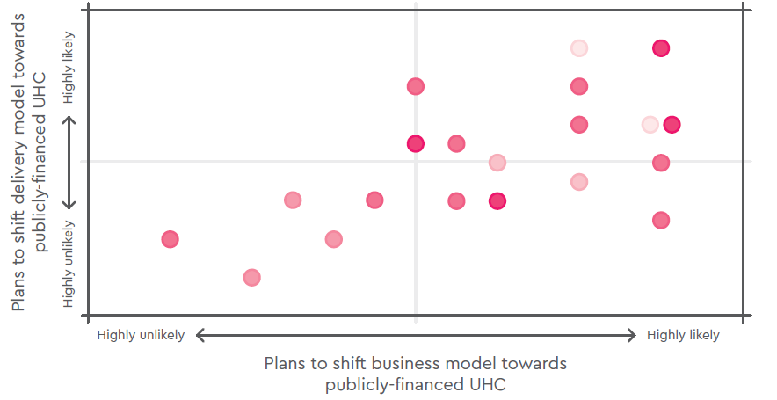
Changing future business models for the private sector
Most large private providers in low and middle income countries are not gearing up for the opportunities of UHC
Expectations of 20 out of 24 of largest provider chains in LMICs on expectations to change business and service delivery models in response to UHC

Slide 12
Changing future business models for the private sector
Most large private providers in low and middle income countries are not gearing up for the opportunities of UHC
Expectations of 20 out of 24 of largest provider chains in LMICs on expectations to change business and service delivery models in response to UHC
Don’t expect
to change
Expect to change
business and
service model
Expect to change
business or service
model, but not both

Slide 13
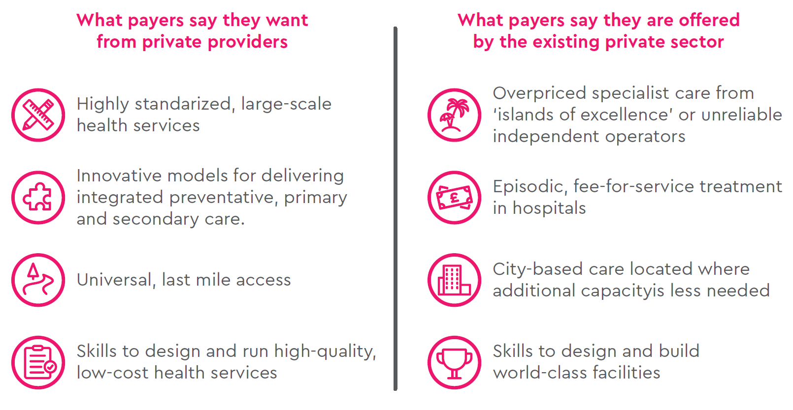
Misalignments between public payers and the private sector

Slide 14
Governments need to decide private sector roles
Governments currently engaged in devising their UHC strategies are faced with a broad array of complex choices about the role they see for private sector providers, including:
1
What services should be purchased from private providers?
2
Who should (and shouldn’t) they be purchased from?
3
How can the right kinds of care be scaled up, and low-value/low-quality services discouraged?
4
How much should be paid and under what kind of contracts?
5
When should private providers collaborate with public ones, and when should they compete?

Slide 15
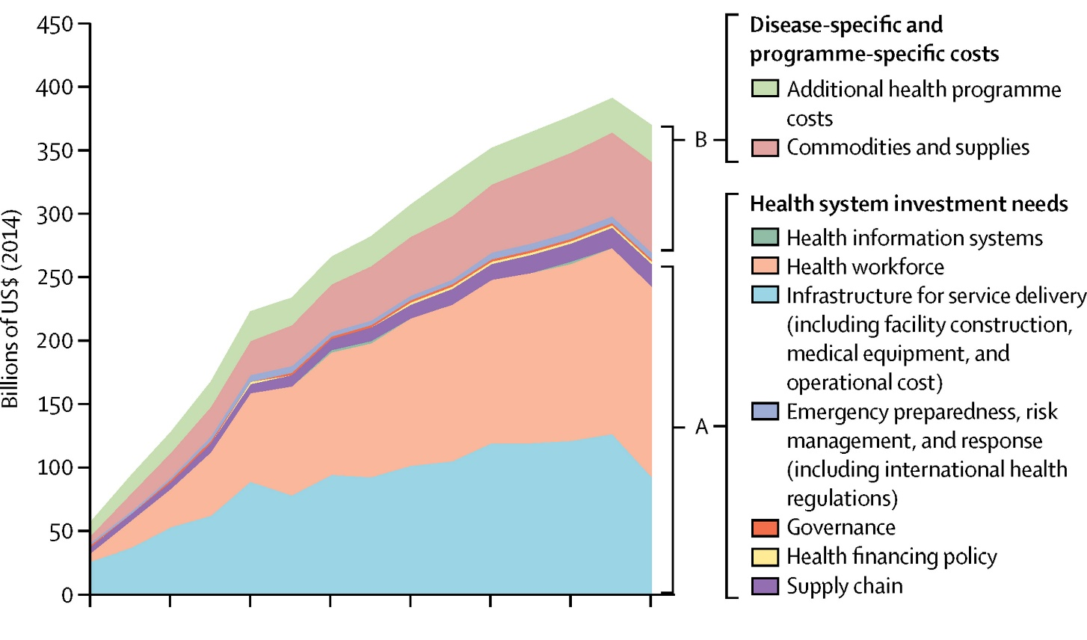

The case for better alignment is compelling
1
The scale of the technical and resourcing challenge facing many countries is enormous
Annual health spending gap
$274-371 bn
across 67 low- and middle income countries to deliver their 2030 UHC commitment
Stenberg K et al. Financing transformative health systems towards achievement of the health sustainable development goals: A model for projected resource needs in 67 low-income and middle-income countries. The Lancet Global Health; 2017

Slide 16
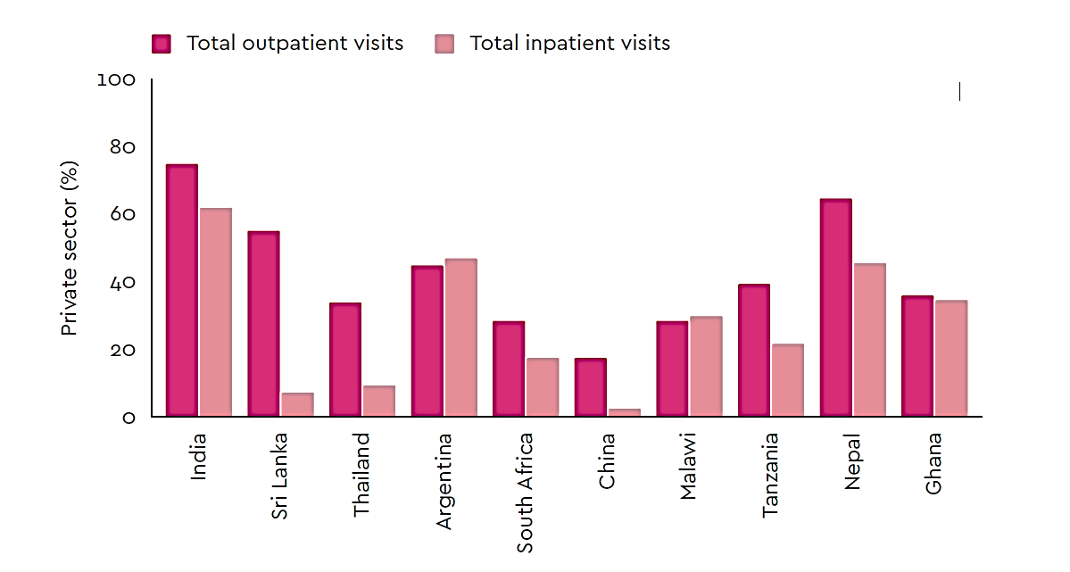

The case for better alignment is compelling
2
The scale of the private health services sector is too big for governments to ignore
More than
50%
report using private providers as first choice for basic care in a survey of 77 low- and middle-income
MacIntosh M et al. What is the private sector? Understanding private provision in the health systems of low-income and middle-income. The Lancet; 2016

Slide 17
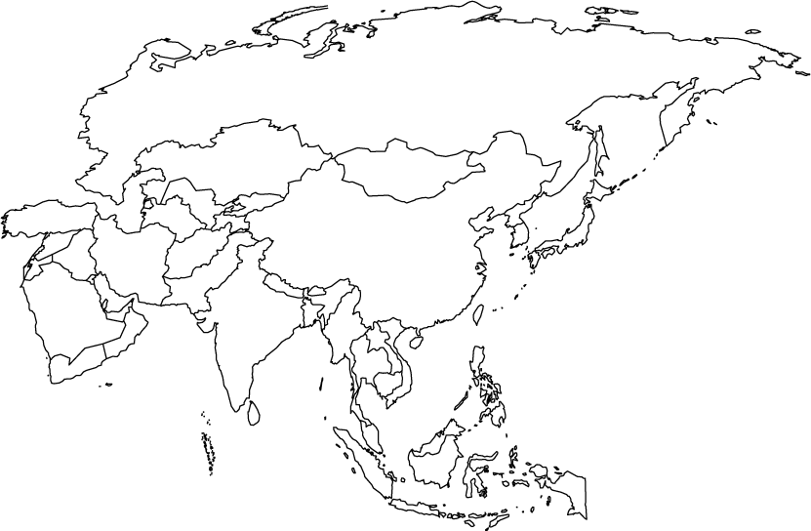


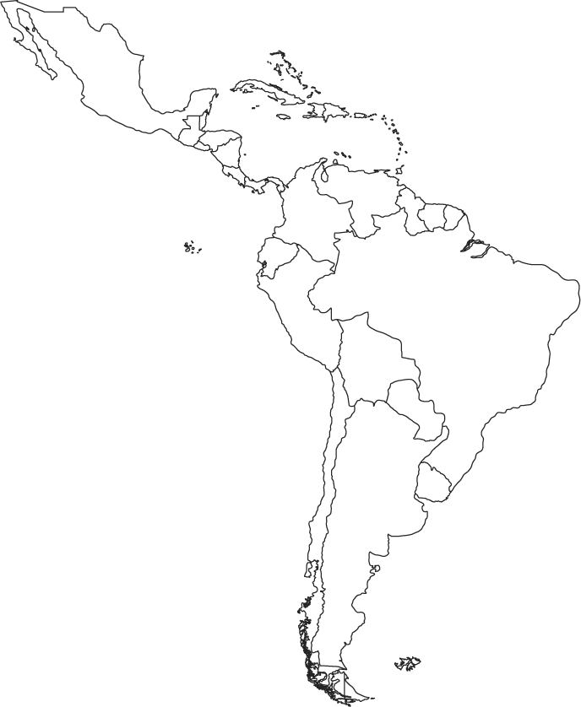



The case for better alignment is compelling
3
Many countries at the forefront of delivering UHC have selected models that signal a heavy reliance on private providers
NHI models with explicit intention to purchase publicly funded health services from private providers
Alternative models show strong growth in size and number of PPPs

Slide 18




Global innovation case studies from the private sector
‘Digital front door to health for all’ – 5 million subscribers now looking to white-label to governments
Rapidly expanding it’s PPP electronic urban primary care centers across multiple Indian states
Low cost, South African pathology provider now joining pan-continental consortium to make major push to African governments
New private hospital with a role designed to complement, rather than compete with existing providers

Slide 19

Five lessons to help Brazil create the right conditions:
1
Provide certainty over future public financing and purchasing of UHC – and follow through on funding commitments.
Provide clarity over the direction of UHC reforms and what is required of public and private providers.
Improve trust between public and private stakeholders through transparency and being a more reliable payer.
Drive out poor performance from all providers using both ‘carrot and stick’ mechanisms.
Encourage and co-invest in new models of care and new market entrants, particularly for primary care.
2
3
4
5

Slide 20

Health is wealth

Slide 21
The information contained herein is of a general nature and is not intended to address the circumstances of any particular individual or entity. Although we endeavour to provide accurate and timely information, there can be no guarantee that such information is accurate as of the date it is received or that it will continue to be accurate in the future. No one should act on such information without appropriate professional advice after a thorough examination of the particular situation.
© 2016 KPMG LLP, a UK limited liability partnership and a member firm of the KPMG network of independent member firms affiliated with KPMG International Cooperative (“KPMG International”), a Swiss entity. All rights reserved.
The KPMG name and logo are registered trademarks or trademarks of KPMG International.
CREATE. | CRT061605 | May 2016

