Slide 1
The Role of Evidence-based Medicine in Eliminating Clinical Waste and
Improving Outcomes.
Margaret-Mary G. Wilson, MD, MBA, MRCP, FNMP
Chief Medical Officer & Senior Vice President,
UnitedHealthcare Global
Notes:
[5 minutes]
Introduction…
Tell story of how you ended up at UHG

Slide 2



Helping people live healthier lives and helping make the health system work better for everyone
Employer & Individual
OptumHealth
Medicare & Retirement
OptumInsight
Community & State
OptumRx
Global
OUR UNITED CULTURE
Integrity
Compassion
Relationships
Innovation
Performance
Notes:
[5 minutes for the business overview]
Quickly to orientate you to the overall enterprise and where the business I represent fits in.
UnitedHealthcare has four business segments…(quick overview of what each one does)
Optum has three business segments…(quick overview of what each one does)
What’s important to note here are the elements that connect all of us in this enterprise, regardless of business segment. We are all driven by the same mission to help people live healthier lives and to help make the health system work better for everyone AND we share a common culture and values that drive HOW we work together. Our five core values underpin every decision we make and action we take as a company.

Slide 3
UNITEDHEALTHCARE GLOBAL
Global Markets
&
Global
Solutions
> 130
6M
medical
members
+2M dental
54
hospitals
~ 225 clinics and outpatient centers
65K
employees
countries
Notes:
We serve members, patients and consumers in two business groupings: Global Markets and Global Solutions
We are serving 7m beneficiaries (6 million of those are medical, 2 million are dental - ~1 million overlap) and operating 54 hospitals and ~240 outpatient and ambulatory clinics.
While the business is heavily weighed towards Latin America, we serve members in over 130 counties around the world.
Our Global Markets business serves specific populations with their in-country healthcare needs. We do this by providing health benefits, medical care delivery and health services to local populations. We have been in Portugal and Brazil for about 5 years and as of early this year, we are now also serve people in Chile, Peru and Colombia.
Our Global Solutions business provides health and well-being solutions for globally mobile populations – primarily expatriates and international travelers.
Throughout all of the business, we focus on clinical integration, health resource alignment, value-based care and the application of evidence based medicine in both health benefits and medical delivery.
Because of this work we do, we have won two consecutive Doyle Awards for innovation and clinical excellence. This is something to be very proud of…UHC Global is the only international organization to ever win this prestigious award and the only payer organization to win in two years in a row.

Slide 4



UNITEDHEALTH GROUP BRASIL
Serving the local population
for more than 35 years
Operates under three
distinct platforms:
Notes:
Let start with our Global Markets…
Our largest business is in Brazil. In Brazil we operate two very large local businesses: a health benefits company and a medical delivery company.
Those two businesses partner with a local Optum in Brazil which serves those businesses through data, analytics and technology.
Now let’s take a closer look at Amil and Americas Medical Services…
NOTE: UnitedHealth Group Brasil is a company name. We do not translate company names, thus Brasil is spelled as it should be in Portuguese, even though this slide is in English.

Slide 5


4M
+
2M
medical members
dental members
34
>95
#1
hospitals
clinics &
outpatient centers
customer service ranking
Doyle Award:
Recognized as market leader in evidence-based medicine
Notes:
As I mentioned, we entered Brazil in 2012 with the acquisition of Amil.
Amil is the largest and most diversified managed care company in Brazil. It offers products that span the entire spectrum of the Brazil private market – from affordable, community-based, vertically integrated health plans to premium health plan offerings with wide network access and concierge services. Amil also provides dental benefits. Our focus is getting people to the most appropriate care, using our health intelligence to get the best health outcomes for people and to keep health care affordable. We also operate 13 hospitals under the Amil brand that serve Amil members.
Amil’s sister company is Americas Serviҫos Médicos (Americas Medical Services). In this business we operate 21 hospitals – many high-complexity, some academic hospitals – that serve the entire community. We also operate more than 95 clinics and outpatient centers. Our focus in this business is quality, evidence-based medicine and whole-person care. In the last several years we’ve invested considerable time and money to build Centers of Excellence across the country – we’ll talk more about those in a moment. Our cardiology COE was recently named as a global COE – one of only 5 global COEs outside of the U.S.
These quality businesses work together to simplify care, improve quality of care, reduce the cost and make health care easier to navigate.
Partnering together, here’s what we’ve accomplished in the last five years:
Doubled the size of the business in terms of revenue
Gone from lowest quadrant of consumer satisfaction to the highest in the country
Grown employee base in number and in satisfaction and engagement
Just last year, we won the Doyle Award for Innovation in Clinical Excellence in health care – this was the first time a company outside the United States has won this award.
And, last year, we opened Latin America’s largest and most-advanced surgical training center. There we have capacity to train over 4,000 surgeons a year across all of Latin America.
That’s the power of Thinking Global and Acting Local.

Slide 6

CHILE | COLOMBIA | PERU
~2M
23K
members
employees
13
115
hospitals
clinics and outpatient centers
Notes:
As you know, Empresas Banmédica is our most recent entry into global markets and the newest addition to our team.
Banmédica is a market leader in both health benefits and care delivery across Chile, Peru and Colombia
With 23 thousand employees, Banmédica serves 2 million members and runs 13 hospitals and 115+ outpatient clinics
As we begin our partnership with Banmédica, we will “Think Global and Act Local” by supporting and empowering the local leaders and the Banmédica business to achieve their strategic objectives.
Banmédica will continue to be run by their local leaders. We admire the work they’ve done to build the company, we admire the quality they bring to their daily work, we admire the leadership team and we admire the frontline clinicians. Our job is to partner and to share capabilities.
Our focus will be to apply our foundational competencies in clinical insights, data / information and technology to drive quality and affordability gains in clinical management and value-based care delivery.

Slide 7

7
hospitals
800
PORTUGAL
hospital beds
2017 Clinical Excellence Ranking
Hospital de Cascais tied for
highest ranking in the country
HIMSS Stage 7
Notes:
Turning now to Europe, our global market business in Portugal is called Lusíadas Saúde.
In Portugal, we operate 6 private hospitals and 1 public hospital. We operate the public hospital in partnership with the Portugal national health system. Since we’ve entered into that partnership, we’ve reduced the cost of operating and managing health care for their population, we’ve reached the number one ranking in clinical excellence in Portugal, and the hospital is now ranked in the top 2.5% of hospitals in the entire EU in terms of data and analytics.
Again, we are proud of the value we can create together when we Think Global and Act Local.

Slide 8





UNITEDHEALTHCARE GLOBAL SOLUTIONS
Expatriate Insurance
Global Insurance & Administration
Administration Services
Travel Insurance
Assistance & Evacuation
Medical & Security
Intelligence
Global Assistance & Risk
Aviation Medical
Emergency Response
Medical Personnel
Global Medical
Clinics
Marine Medical Services
U.S. Networks
U.S. Network Access
Administration Services
2016 Doyle Award: For improving the quality of care delivery and health outcomes for people traveling and living abroad
Notes:
With this business we serve the global health care needs for individuals and employers who live or work outside of their home country.
We do this through four primary product areas: Global Insurance & Administration, Global Assistance & Risk, Global Medical, and U.S. Networks.
We offer a variety of integrated products from global insurance covering individuals wherever they live or travel around the world, to important health service needs like critical case management, evacuation services, emergency response and on-site care for employees that are working in remote locations around the world.
We recognize that in today’s competitive environment, business growth relies heavily on a productive global workforce. Focusing the vast resources of UnitedHealth Group on the specific needs of global employers and employees, we offer broad capabilities that work together to deliver single-sourced solutions which are globally integrated, enabling optimized outcomes.
This business was also honored with a Doyle Award for Innovation and Clinical Excellence in Healthcare because of the strong quality and outcome results these integrated capabilities bring to the people we serve.

Slide 9
Global Opportunity
$4.8 trillion
Global Health Care Challenges
Aging Populations
Chronic Disease Proliferation
Medical Inflation Outpacing Economic Growth
More Engaged and Empowered Consumers
Demand for Access to Higher Quality Care
Limited Services and Delivery Resources
Global* Health Care Market
Public Spend : US $3.3 trillion
Private Spend : US $0.5 trillion
Out-of-Pocket Spend : US $1trillion
* World Bank 2014, excludes $3 trillion US market
Notes:
Molly – 1 min
The Opportunity in Global is significant: 4.8 trillon global health market. We touch a small fraction of that.
Margaret – 2 min
Health care trends and challenges are the same throughout the world as those we solve for day in and day out in the U.S., and more recently in Europe and Brazil:
While each national health system differs, every system struggles with the same three things: access, affordability and outcomes.
Our enterprise is incredibly well positioned to impact those things.

Slide 10
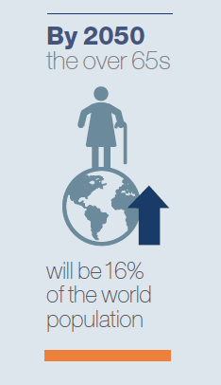
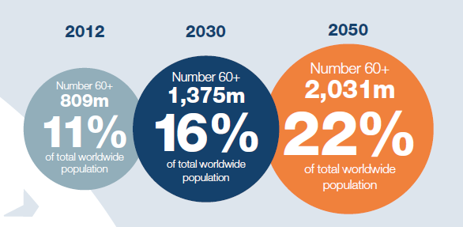
Global Aging Demographics: 2012 - 2050
Source: UNDESA Population Division, World Population Prospects: the 2012 Revision, 21013

Slide 11
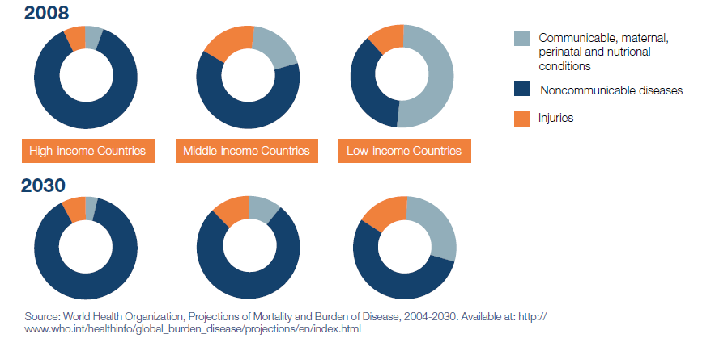
Chronic Non-communicable Disease Burden

Slide 12

Sustainable Healthcare
"A complex system of interacting approaches to the restoration, management and optimization of human health that has an ecological base, that is environmentally, economically and socially viable indefinitely, that functions harmoniously both with the human body and the non-human environment, and which does not result in unfair or disproportionate impacts on any significant contributory element of the healthcare system"
(Alliance for Natural Health, 2008).

Slide 13

A Sustainable Healthcare System
“… ensures that we provide good quality health care today without compromising the ability of future generations to provide good quality health care.”
Scrutton J; Holley-Moore G; Banford S. Innovative solutions for a sustainable 21st century healthcare system. ILC UK; SOS-2020
Notes:
Sustainability is a measure of long-term viability.
Three Ps: People, Profit, Place.
In summary: delivers high quality care without exhausting financial, social and environmental resources.

Slide 14
Distinctive Value Drivers
Clinical Integration
Health Resource Alignment
Value
Based
Care
Evidence Based Medicine
Notes:
Margaret - 3
Throughout all of the business, our distinction lies in our clinical integration, health resource alignment, value-based care and the application of evidence based medicine in both health benefits and medical delivery.
This work has won UHCG two consecutive Doyle Awards for innovation and clinical excellence. UHCG is the only international organization to ever win this prestigious award and the only payer organization to win two years in a row.
Our Global Solutions business won the award in 2016: Working with its international network of physicians, Global Solutions leveraged MCG’s care guideline solutions – augmented by its own data and global clinical expertise – to enhance its inpatient care management support, leading to patients spending 27 percent fewer days in hospital and a 5 percent decrease in international medical evacuations. This resulted in a 35 percent savings in global medical spend and a 24 percent savings in international medical evacuation costs
Our Amil business won the award in 2017: Amil was recognized for being the first healthcare management company in South America to enhance clinical care management using evidence-based guidelines from MCG. The successful initiative simultaneously lowered mortality rates and decreased hospital cost trends. In addition, the endeavor reduced ICU length of stays by 16%, total hospitalization length of stay by 26%, and costs per admission by 7%. Amil leveraged the MCG inpatient and surgical care guidelines to review over 525,400 hospital admissions across 8 of the largest states in Brazil between June 2015 and June 2017. During guideline implementation, their teams saw the additional benefits of improved relationships and cooperation between their clinical teams and private hospitals.

Slide 15
Global Healthcare Management Nuances
Language and cultural barriers
Global nuances in the ‘culture of medicine’
Variations in local standards of care
Differences in patient, provider & client expectations
Inconsistent adherence to evidence-based clinical practice guidelines
Quality assurance and utilization management knowledge gaps
Hospital-centric care delivery models
Misaligned incentives between stakeholders (Fee-for-service environment)
Variations in maturity of patient safety programs
Unpredictable clinical operational logistics
Notes:
Starting first with some of the differences we think about when operating a global care management business
Many of you may note that many of the fundamental challenges of management in the international space look a lot like the fundamental challenges of management in the US. You would be correct. However, there are some unique twists. (Go through slide)
Text from deleted slide
Health care is a constitutional right in Brazil
Huge demand on the public healthcare system
Public system learns from the private system
Care delivery is hospital-centric and specialty-driven
Went from nonexistent to the first most utilized specialty in Rio de Janeiro; gains continue in Sao Paulo
Experiencing some of the same consolidation in health care as we see in the U.S.

Slide 16
Value Proposition
Improve healthcare for the people and systems we serve by harnessing global capabilities together with local market understanding
THINK GLOBAL
ACT LOCAL
Advance local healthcare access, affordability and outcomes by leveraging foundational competencies in data analytics, technology and clinical insights
Notes:
Molly - 4
Our unique value proposition across all of our businesses is “think global and act local”
What I mean by that is the intentional combination of enterprise capabilities with local market insights and management to advance modernization across health access, affordability and outcomes.
The balance is really important. US products really don’t work outside the US. However, our locally adapted capabilities are powerful.
As we mature, we will progress this model to be less US centric. In addition to connectivity and sharing from the US, horizontal knowledge transfer market to market is powerful. As is, bringing innovation from these cost constrained markets to the US.

Slide 17
Today’s Topics
A Case Study:
Advancing Evidence-Based Care In Brazil
17
Notes:
[10 minutes for this section]
With that understanding of Brazil as backdrop, let’s get into the meat of what I’m here to talk with you about today and what will be the focus of our conversation is the work of advancing evidence-based care outside the U.S.
Evidence-based medicine is not new.
It is a critical ally in improving the care patients receive.

Slide 18
Challenges
Challenge:
Variations in quality of care in Brazil
Action:
Ensure patients have consistent access to
high quality health care
Steps:
Implementation and rigorous application of evidence-based care guidelines
Challenge:
Inconsistent provider adherence to evidence-based practice standards
Action:
Support high quality health care access and delivery in Brazil
Steps:
Educate providers; ’share the evidence’; influence and negotiate
Notes:
So, we had a set of challenges that needed to be overcome. We had the idea that we would strive for quality. We had the belief that cost savings would flow from quality. And we started to design the model.
Our first challenge was variation in quality of care.
We made an assumption: We noted that the medical evidence does not change country to country. Pneumonia should be treated the same way no matter where you are in the world. Thus, the expectations of quality care are universal.
Our solution was to use evidence based care guidelines. For us, this was MCG
The benefits to using the evidence based guideline for our clinical team was that it provided
1. Insight into current and potential medical needs based on diagnosis and drives effective care
2. Insight into potential complications
3. Insight to projected recovery course
4. Allows for proactive discharge planning
5. Allows evacuation or repatriation planning if required

Slide 19
Leverage evidence-based guidelines to improve critical care clinical outcomes in Amil members
        MCG Care guidelines were adopted and implemented as the evidence-based clinical
        care management resource
        MCG offer access to evidence-based best practices and care-planning tools that support
        clinical decision-making and enable efficient transitions between care settings.
        MCG provides insight into critical benchmarks such as length of stay, re-admissions,
        and skilled nursing facility/inpatient rehabilitation admission rates.
Amil is the first managed care organization to use MCG in South America

Slide 20
Implementation Process Overview
Implemented MCG Care Guidelines in 108 hospitals in Brazil:
        Inpatient Medical & Surgical guidelines in June 2015
        Intensive care guidelines in July 2016
All Amil Care Management Physicians and Nurses received formal training in MCG application
MCG Guidelines were used by the Amil team to engage intensive care physicians and facilitate evidence-based care of critically ill patients

Slide 21
Results
Reviewed 423,196 adult hospital admissions between June 2015 - June 2017 comprising 59,394 ICU admissions [14% (80% medical admissions)]
Outcome measures:
    Length of stay
    Mortality
    Readmission rates
    Cost per admission
Notes:
Amil reviewed more than 525,000 hospital admissions across eight of the largest states in Brazil between June 2015 and June 2017. During this time, we saw additional benefits from improved clinical care management, improved operational efficiency, and enhanced relationships and collaboration with private hospitals.

Slide 22
Deep Dive: Results
 | Pre-implementation | Post-implementation | P-value
Age (years) | 63.2±19.6 | 63.4±19.7 | 0.46
Male (%) | 47.2% | 47.5% | 0.65
Medical diagnosis (%) Community-acquired pneumonia/sepsis Acute coronary syndrome Stroke | 79.1% 1355 1123 592 | 79.6% 1450 1124 598 | 0.42
Surgical diagnosis (%) Cardio-thoracic Orthopedic Craniotomy | 20.9% 358 273 152 | 20.4% 330 282 131 | 0.41

Slide 23
Deep Dive: Results
 | Pre-implementation | Post-implementation | Trend | P-value
ICU LOS (days) | 4.2±0.2 | 3.5±0.6 | -16% | <0.001
ALOS-GLOS ICU (days) | 1.7±0.2 | 1.5±0.3 | -9% | 0.38
Hospital LOS (days) | 17.2±2.1 | 12.7±0.9 | -26% | <0.001
30-day readmission (%) | 13.7±0.7% | 13.4%±0.3% | -2% | 0.21
Hospital mortality rate (%) | 9.0%±0.5% | 8.7%±0.2% | -3% | 0.75

Slide 24
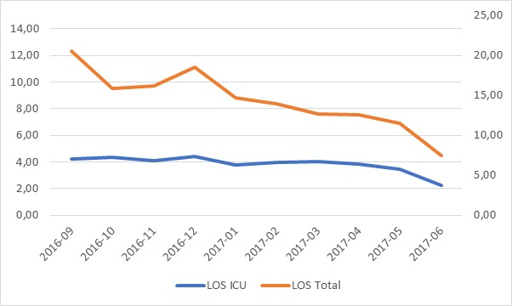
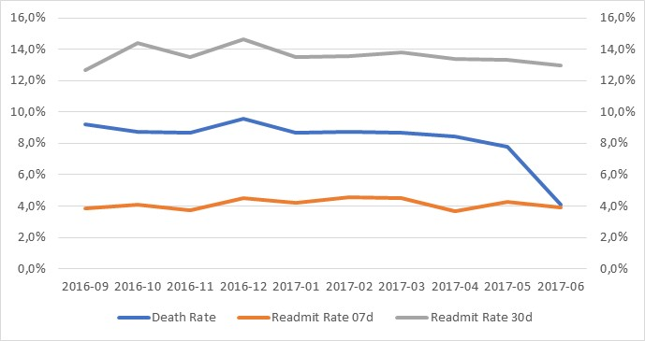
Deep Dive: Results
READMISSION RATE
AND MORTALITY
LENGTH OF STAY

Slide 25


Results Highlights
Decreased ICU mortality rate by 6%
Reducing ICU length-of-stay by 16%
Decreased total hospital length-of-stay by 26%
Lowered cost per admission by 7%
Notes:
Reduction in inappropriate admissions and length of stay.
Saw no deterioration in clinical outcomes.
This was the beginning; we showed the impact of these areas.

Slide 26

Qualitative Impact
Eliminated myths and misperceptions regarding global care standards
Supported shift from an access-based to a quality-based global model
Increased decision-making confidence and competence of reviewers
Increased awareness of impact of variations in care
Enhanced provider engagement and relationships
Enhanced thought leadership in global health care arena
Enhanced organizational clinical value proposition
Notes:
Now we do international patient safety and quality. Beginning of our walk; not at the end.
We’ve shown globally that when you focus on doing the right thing for the patient, the patient and the providers are happy. You have better patient satisfaction and clinical results are improved.
If you do the right thing, everyone wins.

Slide 27
Critical Learnings
Leverage high-quality, evidence-based data and benchmarks
Recognize and address cultural nuances
Engage the providers at point-of-service
Utilize accessible, evidence-based care pathways that align with workflow process
Communicate, train and socialize
Define specific objectives
Anticipate resistance
Identify internal and external stakeholders
Secure visible leadership buy-in
Leverage globalization champions
Notes:
Think long and hard about what you are trying to accomplish. What is your fundamental conviction….your touch stone? You have to have clarity in your own mind before you can make any changes. You have to drive the message.
Our argument was based on quality. Poor quality is bad. Good quality is good. Poor quality leads to additional issues – complications, unnecessary testing, prolonged length of stay, increased costs. We concentrated on the quality by concentrating on the evidence. Our mantra was: The savings will flow naturally from the improvement in quality.

Slide 28
Critical Learnings
Articulate a clear mission, vision and common purpose
Generate supportive corporate culture
Develop a dynamic training program
Define performance / outcome measures
Encourage innovation and flexibility
Implement continuous quality improvement
Conduct robust data analysis to sustain positive outcome
Notes:
Articulate a clear vision. To do this, you need to be clear in your own mind. Build your plan around your challenges and the solutions to those challenges. You may be told you are wrong. Keep the faith.
Generate a supportive corporate culture. Keep talking about your vision.
Train your team.
Define performance and outcome measures.
Encourage innovation and flexibility. Let the team innovate.
Implement continuous quality improvement. Let the those who do the work on a daily basis, lead the improvement. Let them see the plan and let them tear it apart. Yep, let them tear it apart. Then let them help you rebuild it. Don’t alter the end point, only the processes to get there.
Conduct robust data analysis to sustain positive outcomes.
Articulate a clear mission, vision and common purpose
Generate supportive corporate culture
Develop a dynamic training program
Define performance / outcome measures
Encourage innovation and flexibility
Implement continuous quality improvement
Conduct robust data analysis to sustain positive outcome

Slide 29
Q&A
  Thank you!
Notes:
[20 minutes for this section]
Thank you for having me.
Now I’m happy to take your questions…

