Slide 1
Looking Ahead:
Waste and the Future of Health Care
Ezekiel J. Emanuel, M.D., Ph.D.
University of Pennsylvania

Slide 2

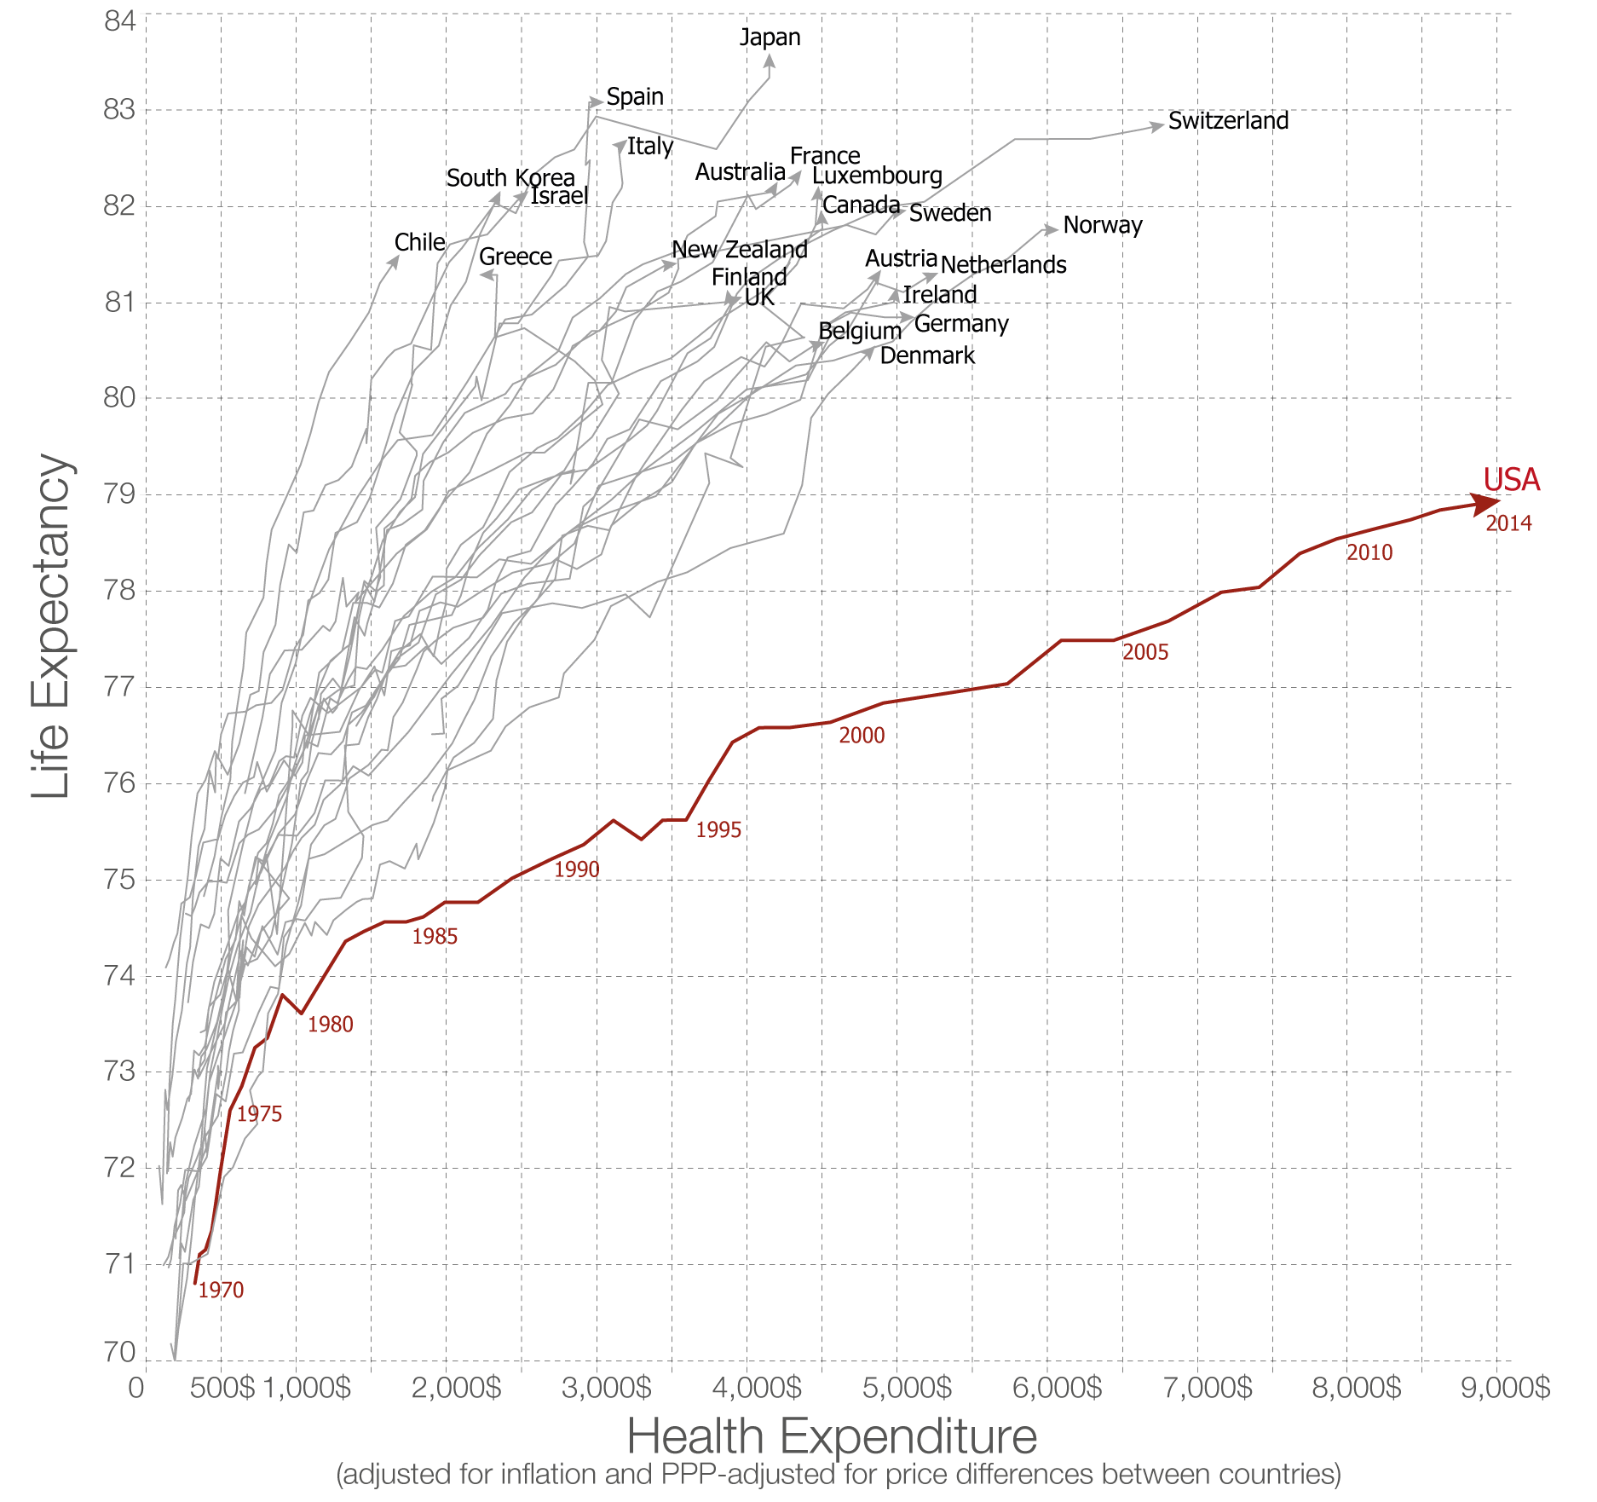
Life Expectancy vs. Health Spending (1970-2014)
Source: health expenditure from the OECD; life expectancy from the World Bank.
Licensed under CC-BY-SA by the author Max Roser

Slide 3
Two Trends
Measure | USA | FRANCE | BRAZIL
Health Care Cost per person (2015, PPP) | $9,451 | $4,407 | $780
Average Life Expectancy | 79.3 (31st) | 82.4 (9th) | 75.1 (67th)
Infant Mortality (per 1,000 births) | 5.80 | 3.30 | 14
Cancer 5-year survival Breast Colon Childhood Leukemia | 88.6% 64.7% 87.7% | 86.9% 59.8% 89.2% | 75.2% 42.9% 66.0%
WHO Health System Ranking* | 37 | 1 | 125
* Based on a composite score of health, health inequality, responsiveness-level, responsiveness distribution, and fair financing.
Notes:
https://data.oecd.org/healthstat/potential-years-of-life-lost.htm

Slide 4
The Difference
The difference between the USA, France, and Brazil is NOT:
  Discovery of a master gene
  Deployment of an advanced high technology machine
  Access to a new drug
The difference is HOW care is delivered.
Notes:
Sources:
http://www.rwjf.org/en/library/research/2016/06/the-widespread-slowdown-in-health-spending-growth-implications-f.html
https://www.hhs.gov/about/news/2016/09/14/new-data-show-major-improvements-health-care-access-affordability-and-quality-under-affordable-care

Slide 5
Definitions
Inefficient care is care that is more expensive but leads to the same clinical outcome
Unnecessary care does not add to health and simply creates more expense.

Slide 6

Inefficient Care
Notes:
https://www.ncbi.nlm.nih.gov/pubmed/12165639

Slide 7
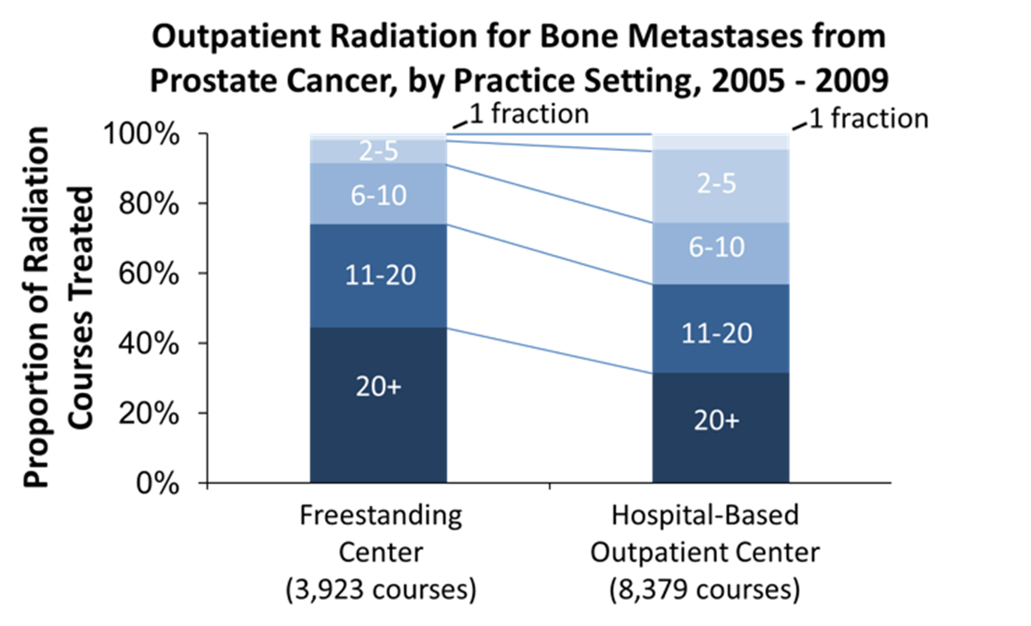
Inefficient Care
Source: Justin Bekelman. Toward Accountable Care in Radiation Oncology. IOM Affordable Cancer Care Workshop. 8 Oct, 2012.

Slide 8
Inefficient Care
Breast Cancer Irradiation Outcomes by Treatment Duration
 | 3 Weeks | 7 Weeks
5-year local recurrence-free survival | 97.2% | 96.8%
Excellent/good global cosmetic outcome at 3 years | 76.8% | 77.0%
Excellent/good global cosmetic outcomes at 5 years | 76.8% | 77.4%
% Women receiving | 34.5% | 65.5%
*No difference in overall survival rates was detected between study arms.
Whelan T, MacKenzie R, Julian J et al. Randomized trial of breast cancer irradiation schedules after lumpectomy for women with lymph node-negative breast cancer. J Natl Cancer Inst. 2002; 94(15):1143-50.
Notes:
https://www.ncbi.nlm.nih.gov/pubmed/12165639

Slide 9
Unnecessary Services
PET/CT scans ordered during diagnosis and staging
Local stage breast cancer, 0-2 comorbidity
High volume oncology clinics, Puget Sound
Source: Scott Ramsey. How Should We Define Value in Cancer Care. IOM Affordable Cancer Care Workshop. 8 Oct, 2012.

Slide 10
The Impact
The Institute of Medicine estimates that 30% of all money spent on health care in the US is wasted.
Inefficiency: 17%
Unnecessary care: 28%
Notes:
https://khn.org/morning-breakout/iom-report/
https://www.nap.edu/read/13444/chapter/3#13

Slide 11
Future Trends of High-Value Care
Private-sector driven changes.
Shift towards value-based payment.
VIP care for chronic conditions.
Greater use of non-physician providers.
The deinstitutionalization of care.
The performance measurement of physicians and other providers.
The incorporation of behavioral health in regular care.
Excessively high drug prices.

Slide 12
High-Cost Care
86% of all health care spending is for patients with chronic illnesses.

Slide 13
How do we eliminate inefficiency and unnecessary care?
1. Macro incentives – payment reform
2. Lean implementation
3. Process changes

Slide 14
Macro Incentives: Payment Reform

Slide 15
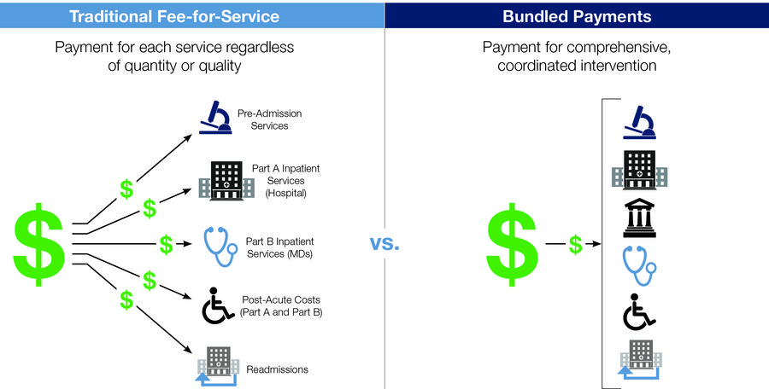
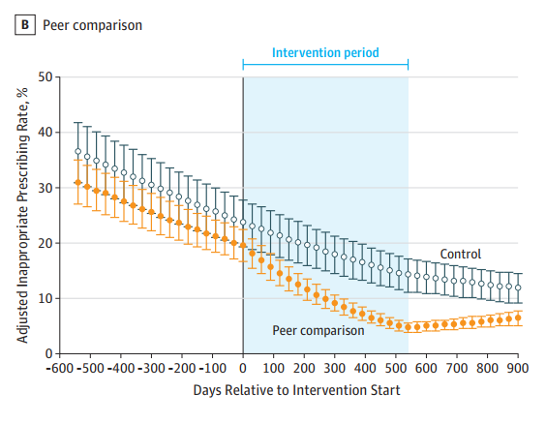
Value-Based Payments: Bundles
Source: Linder et al, JAMA 2017

Slide 16
Value-Based Payments: Bundles
Dimension | Effect of Bundled Payment
Mortality
Readmission/ER Use
Walking up and down 12 stairs
Pain limiting activity
Patient Satisfaction
Dimension | Effect of Bundled Payment
Mortality
Readmission/ER Use
Walking up and down 12 stairs
Pain limiting activity
Patient Satisfaction
6%
4%
Source: Linder et al, JAMA 2017
Notes:
Dummit LA, Kahvecioglu D, Marrufo G, et al. Association Between Hospital Participation in a Medicare Bundled Payment Initiative and Payments and Quality Outcomes for Lower Extremity Joint Replacement Episodes. JAMA. Published online September 19, 2016.

Slide 17
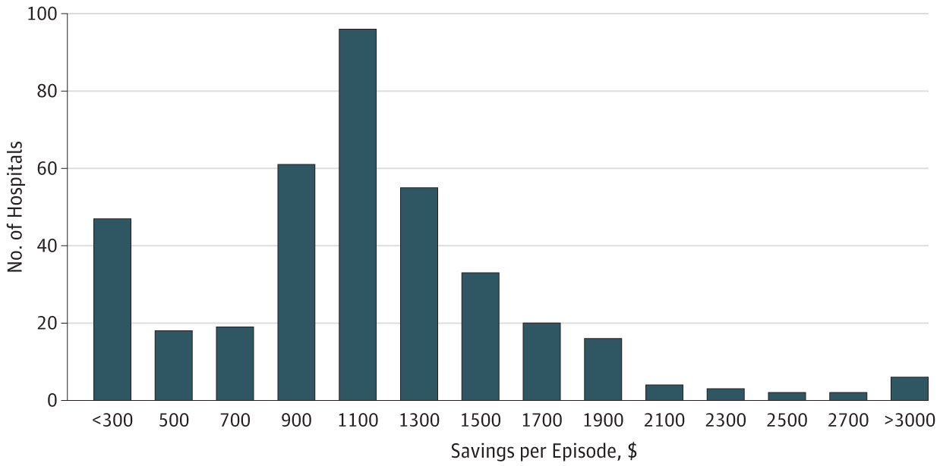
Results of CJR
Navathe AS, Liao JM, Shah Y, et al. Characteristics of Hospitals Earning Savings in the First Year of Mandatory Bundled Payment for Hip and Knee Surgery.
JAMA. 2018;319(9):930–932. doi:10.1001/jama.2018.0678

Slide 18
Value-Based Payments: Bundles
Cost = Price * Volume
Bundles affect the prices and the volume of expensive procedures and services.

Slide 19
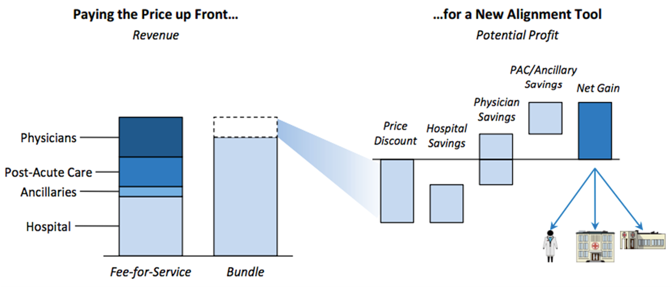
What are bundled payments?
Source: The Advisory Board Company. 2015.

Slide 20
Hospital View of Savings
Panel A: Internal hospital cost components and post-acute care spending
Panel B: Post-acute care spending components
BPCI Year 2
ACE Year 3
BPCI Year 2
Navathe AS, Troxel AB, Liao JM, Nan N, Zhu J, Zhong W, Emanuel EJ. Cost of Joint Replacement Using Bundled Payment Models. JAMA Intern Med.
2017;177(2):214–222. doi:10.1001/jamainternmed.2016.8263
Notes:
From July 2008 - June 2015, average Medicare episode expenditures declined 20.8%, from $26 785 to $21 208 for 3738 episodes of joint replacement.

Slide 21
Savings in Bundled Payment
Prices:
  Reduced prices for implants and inputs.
Volume
  Shift of post-acute care from institutions to home.
Efficiency
  Increased efficiency due to shorter procedure durations.
  Shifting procedures towards lower-cost facilities (ex: from hospital to ambulatory surgical centers)

Slide 22
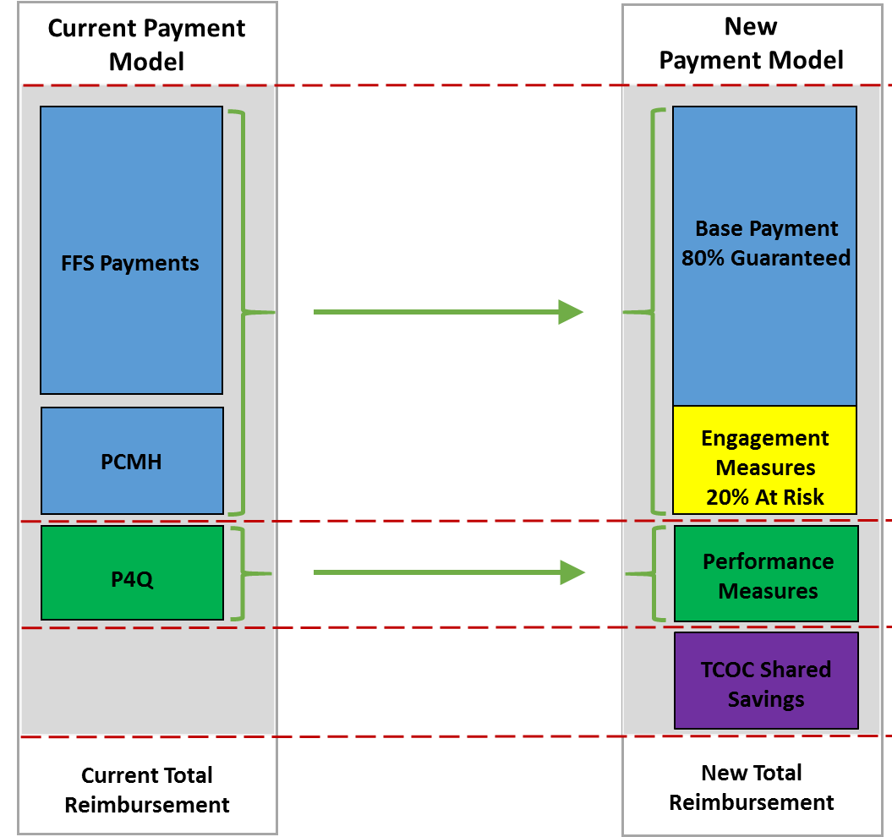
Capitation for PCP
2015
2016+

Slide 23
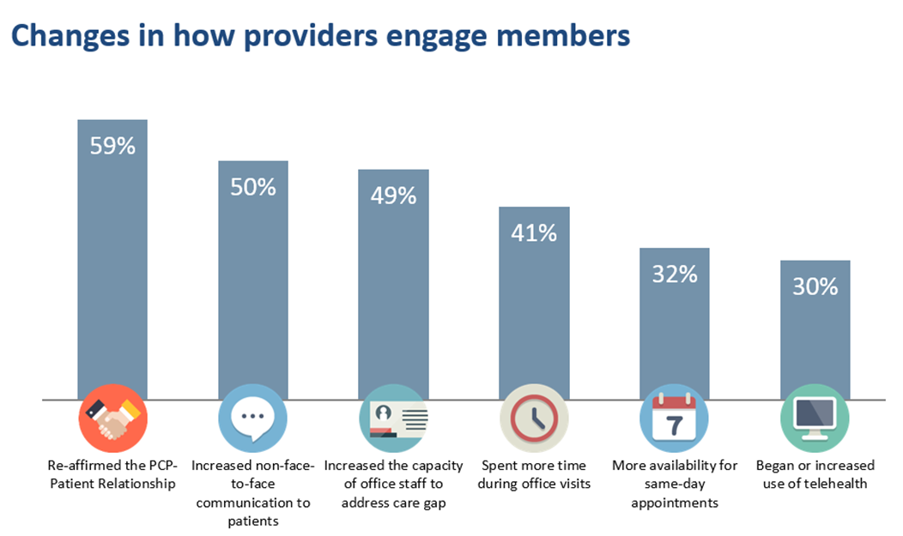
Member Engagement Changes

Slide 24
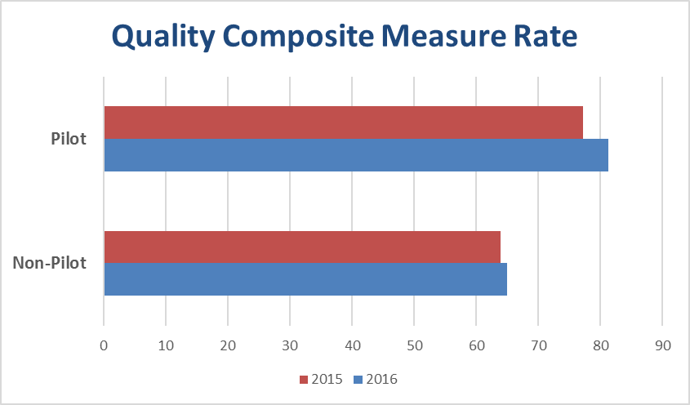
Quality: 2015 vs. 2016
4.09%
0.97%

Slide 25
Massachusetts AQC
In 2009, Blue Cross Blue Shield of Massachusetts (BCBS) implemented Alternative Quality Contract (AQC), beginning with 20% of BCBS HMO members
By 2012, 85% of physicians in the BCBS HMO network were in an AQC
Tufts Health Plan and CMS’ Pioneer ACO Model followed suit in 2012 and brought 72% of its managed care enrollees under global budgets

Slide 26
AQC spending grew $62 per enrollee per quarter, less than control for 6.8% savings
Source: Song Z, Safran DG, et al. Change in health care spending and quality 4 years into global payment. N Engl J Med. 2014 Oct 30;371(18):17044-14
Notes:
Unadjusted claims spending in the 2009 AQC cohort grew slower after entering the contract, as compared with the control group (Fig. 1). In the adjusted analysis, medical spending grew an average of $62.21 per enrollee per quarter less in the AQC cohort than in the control group during the 4-year postintervention period which was an average savings of 6.8% as compared with the average postintervention claims spending level in the AQC cohort (Table 2). Preintervention trends did not differ significantly between the AQC group and the control group (difference, −$4.57; P=0.86), suggesting that differences in postintervention spending were not driven by inherently different trajectories of spending. No differential changes in the DxCG risk scores were found between the AQC group and the control group (difference, −0.0015; P=0.57), suggesting that coding behavior did not meaningfully affect the results.

Slide 27
Total MA AQC savings

Slide 28
MA AQC Savings
Early in the program (years 1-4), 60% of savings came from lower prices, mainly by going to lower cost hospitals and other providers. 40% came from reduced utilization.
But later (years 4-8), about 60% of the savings accrued from reduced utilization, and only 40% from pricess.

Slide 29
Lean Implementation

Slide 30
Hospitals Consume a Massive Proportion of Health Spending
Source: Altarum Institute, 2016
Notes:
https://altarum.org/sites/default/files/uploaded-related-files/CSHS-Spending-Brief_February_2017.pdf

Slide 31
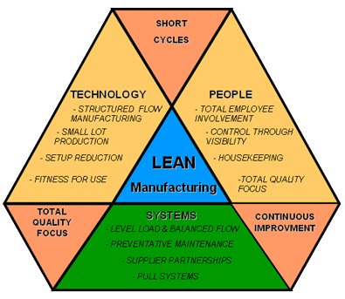

Adapt and Implement LEAN Production Practices for Inpatient Care
Notes:
https://altarum.org/sites/default/files/uploaded-related-files/CSHS-Spending-Brief_February_2017.pdf

Slide 32
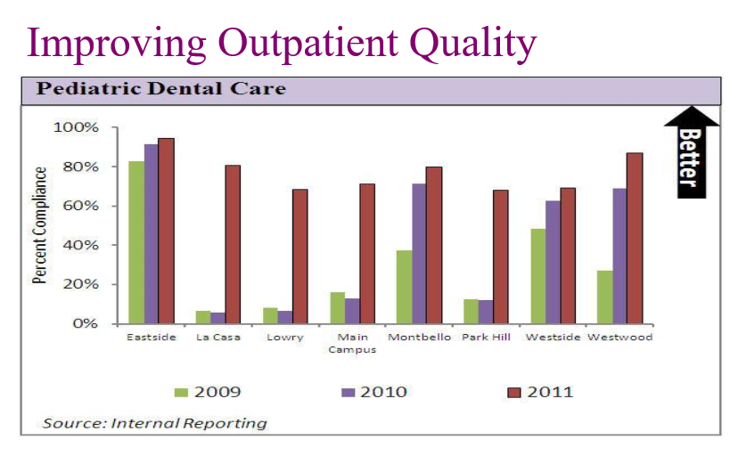
Example: Denver Health System
Notes:
http://www.clevelandclinicmeded.com/live/courses/cisummit/post-syllabus/1500%20Goodman%20Rm%20207%20Goodman%20Lean%20FINAL.pdf

Slide 33
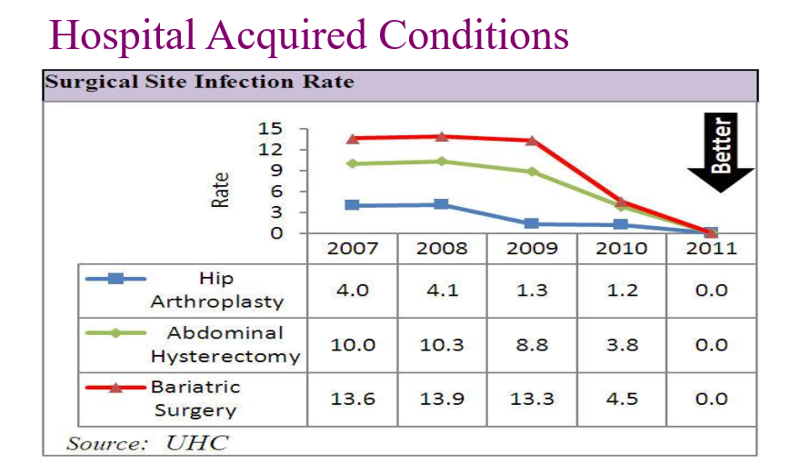
Example: Denver Health System
Notes:
http://www.clevelandclinicmeded.com/live/courses/cisummit/post-syllabus/1500%20Goodman%20Rm%20207%20Goodman%20Lean%20FINAL.pdf

Slide 34
Example: Denver Health System
Increased outpatient volume by 5%
$160 million in savings over 5 years
No one laid off

Slide 35
Process Changes

Slide 36
Deinstitutionalization – USA

Slide 37
Deinstitutionalization – USA

Slide 38
Deinstitutionalization – USA

Slide 39
Move Care Out of Hospitals Into Ambulatory Centers
Surgery
Radiology
Rehab
Oncology
Ambulatory surgical centers
Ambulatory imaging
Ambulatory physical therapy
Office or home
Notes:
https://www.kff.org/health-costs/poll-finding/kaiser-health-tracking-poll-june-2015/
https://aspe.hhs.gov/system/files/pdf/187586/Drugspending.pdf

Slide 40
Hospital @ Home
At Presbyterian Health Services, Albuquerque, NM
 | Hospital @ Home | Inpatient
Mean length of stay | 3.3 days | 4.5 days
Quality metric compliance | 100% | 91-97%
Rates of falls | 0% | 0.8%
Rate of readmission with 30 days | 10.8% | 10.5%
Mortality | 0.93% | 3.4%
Patient satisfaction score | 90.7 | 83.9
E.A. Mann; M.A. Haggerty; A. Feinberg; R.K. Miller;J. Hammond; B. Kinosian. Delivering hospital at home services safely and inexpensively through community partnerships.
Notes:
https://www.kff.org/health-costs/poll-finding/kaiser-health-tracking-poll-june-2015/
https://aspe.hhs.gov/system/files/pdf/187586/Drugspending.pdf

Slide 41
Move Care Out Ambulatory Centers to Home
The next phase is moving care out of ambulatory facilities – both imaging centers and physician offices – and into the home.
Routine office visits, for example, could easily be made at home.
Several practices may be adopted to facilitate this transition:
  Telephone and internet triage
  More providers offering 24/7 access
  Uptick in house calls and providing hospital services in the home
Notes:
https://www.kff.org/health-costs/poll-finding/kaiser-health-tracking-poll-june-2015/
https://aspe.hhs.gov/system/files/pdf/187586/Drugspending.pdf

Slide 42
Independence at Home
CMS’ Independence at Home Demonstration provides chronically ill patients with primary care services in the home setting.
Patients are eligible if they are:
  Enrolled in Medicare
  Have 2+ chronic conditions
  Have had a hospital admission within the past 12 months
  Have received acute/sub-acute rehabilitation services within the past 12 months
  Require assistance of another person for 2+ activities of daily living (ADL)

Slide 43
Independence at Home
The 6% of Medicare patients eligible for Independence at Home account for nearly 30% of Medicare spending.
In 2016, the 15 participating practices saved $7,821,374 in aggregate.
Savings primarily resulted from fewer ER visits and hospitalizations, and shorter lengths of stay.

Slide 44
Palliative Care
“If you ask a doctor, ‘Would you be surprised if this patient passed away in the next year?’ and the answer is no, then they’re a good fit for palliative care…We have the privilege to walk with people through a really difficult part of life.”
~ Brad Smith
Aspire Health founder
Notes:
https://matter.health/news/the-accidental-entrepreneur-brad-smiths-journey-from-politics-to-business/

Slide 45

Palliative Care
Aspire Health is a for-profit company that specializes in providing palliative – but not hospice – care to patients who have a life expectancy of 1 year or less.
Aspire hires palliative care specialists who oversee palliative care NPs.
The model allows patients to stay at home and access care 24/7.

Slide 46
Palliative Care
Aspire NPs play a crucial role, responsible for such tasks as:
  Visiting patients in their homes
  Addressing patients’ symptoms and concerns
  Helping patients fill out advanced care directives and POLST forms
  Ensuring the patients have and take their medications
  Educating the family about what to do in the case of an emergency
  Consulting with the PCPs to initiative hospice care when necessary

Slide 47
Palliative Care
< 5% of Aspire patients die in hospital, compared to over 20% of Medicare patients with cancer.
< 50% the hospital admissions in last year of life compared to control patients.
15-20% cost savings in the last year of life.

Slide 48

Timeline of Transformation

Slide 49

Conclusion

Slide 50



Receive specialized training in health care innovation from the University of Pennsylvania, through online courses designed for working professionals who can immediately put their new knowledge into practice. Complete four courses in one year to earn a Professional Development Certificate in
Health Care Innovation.
I now have the right tools required in my role
and much more confidence to lead change in my organization.
– Diane Pearce
Manager, Business Change, CareMore
Take courses taught by internationally recognized leaders from the Perelman School of Medicine and The Wharton School.
Courses include:
The American Health Care System
Behavioral Economics and Decision Making
Evaluating Health Policy and Programs
Health Care Operations
Health Economics
Translating Ideas into Outcomes
www.improvinghealthcare.net

