Slide 1
Achieving a breakthrough in the quality, safety, timeliness and affordability of care
Alex Knight
November 9th 2018

Slide 2
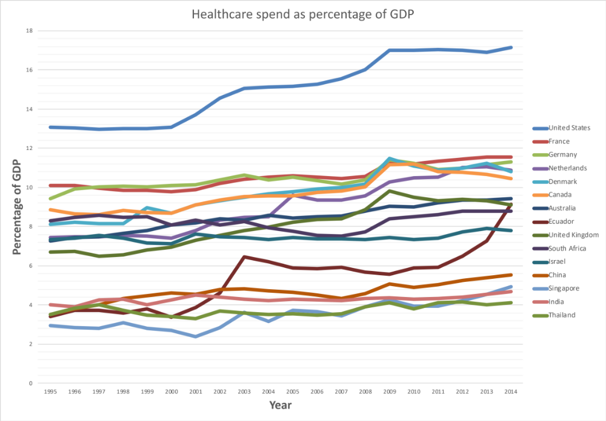
Global healthcare finances
Source: www.data.worldbank.org

Slide 3
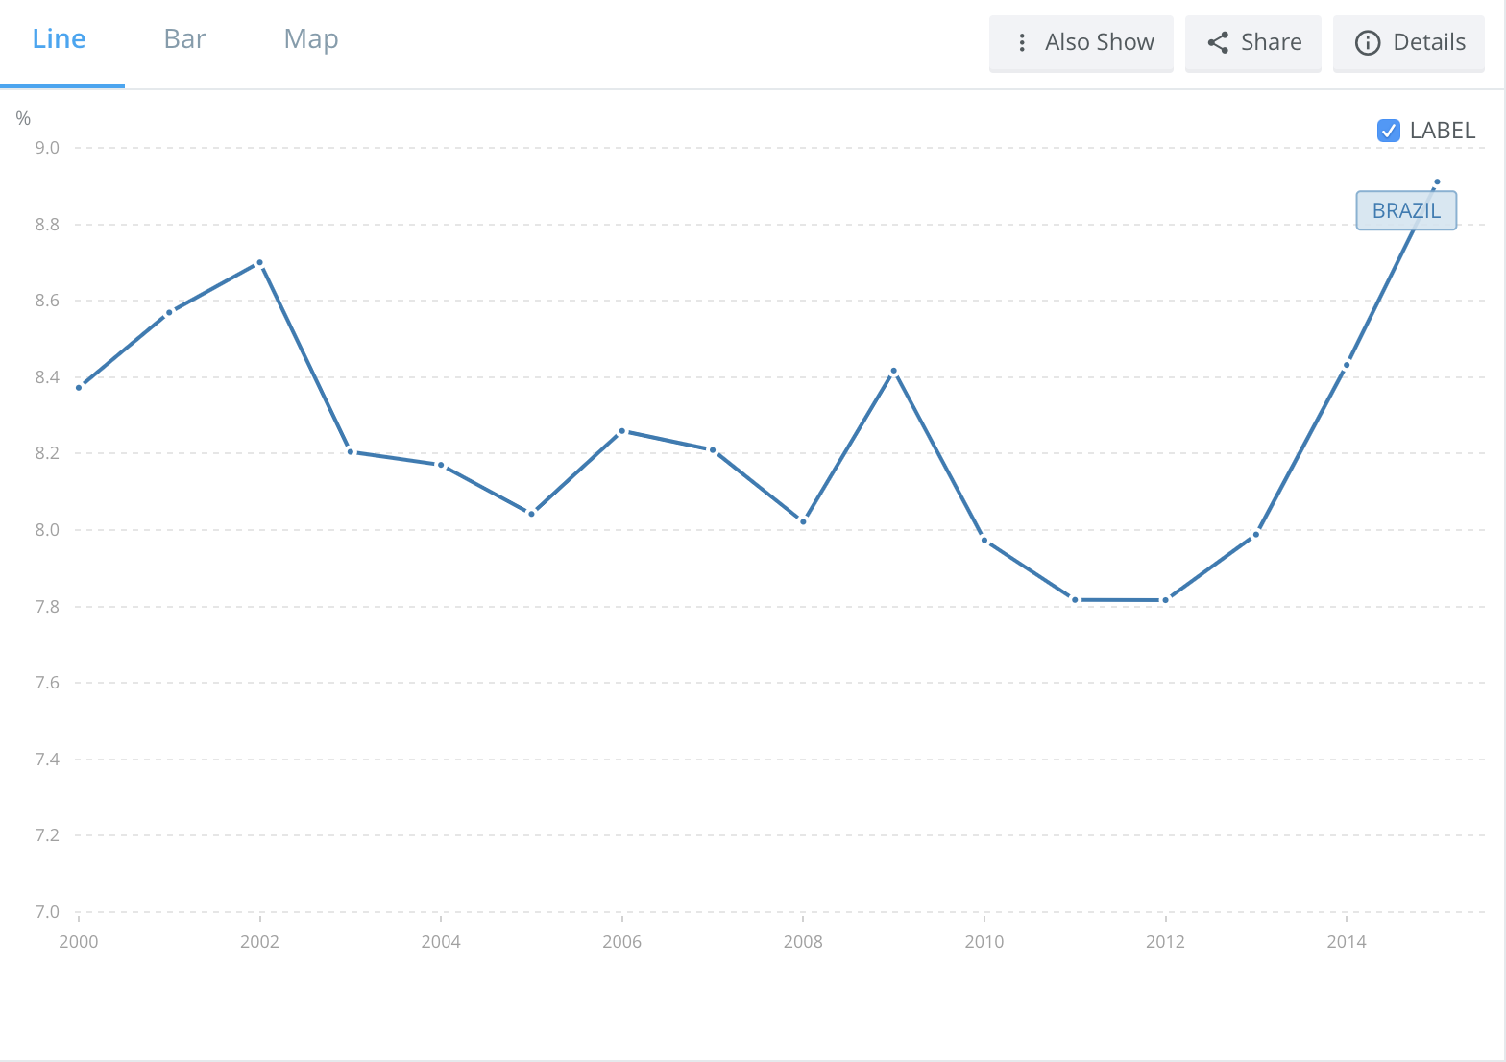
World Health Organization Global Health Expenditure database
(apps.who.int/nha/database)

Slide 4
A health and social care system
Home
Home
Home
Home
Days
Days
Days
Community health & social services
Community health & social services
Community health & social services
4 hours
12 hours
Ambulance
arrivals
ED
AU
Acute
Rehab, Community, Mental Health
Residential, nursing care
Minor walk-ins
Electives
Days
Days
Weeks
GP referrals
Outpatients
Community health & social services
Community health & social services
Community health & social services

Slide 5

Healthcare systems are increasingly between a rock and a hard place
The hypothesis in Pride and Joy
REQUIREMENT
Provide high-quality, safe and timely care for all patients
ACTION
Add more
(front-line) resources
Budget overruns
OBJECTIVE
Be an ever-flourishing healthcare system
Conflicting decisions about where best to spend money
CONFLICT
REQUIREMENT
Be
financially
stable
ACTION
Reduce
(front-line) resources
Quality of care is compromised

Slide 6
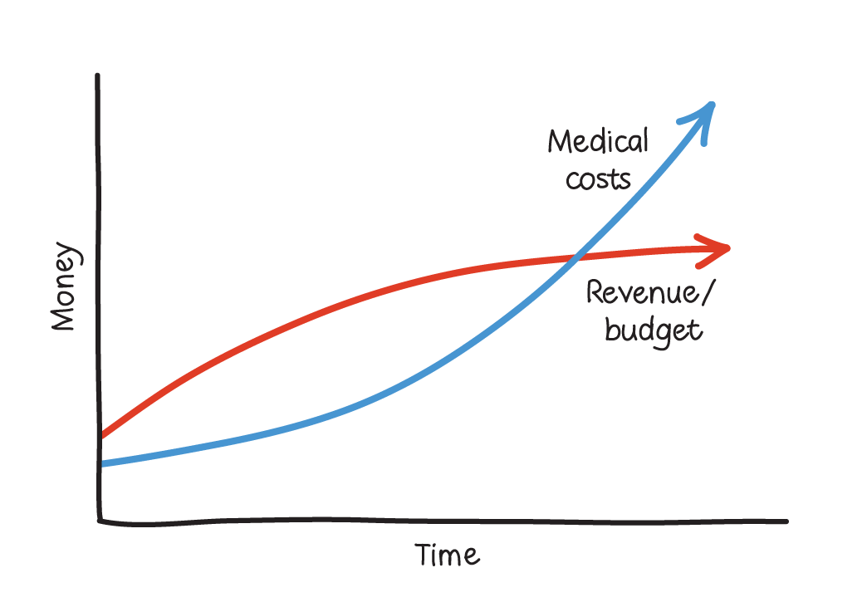
Why is this important situation becoming increasingly urgent?
It is important to notice that the cause of this problem cannot be
simply placed at the feet of the people running the system.
‘The core problem of healthcare’, Dr Eliyahu M. Goldratt, www.toc.tv. See Pride and Joy, pages 63-64.

Slide 7
Criteria against which a solution should be judged
Any solution must simultaneously:
create an ever-flourishing health and social care system
rapidly improve the quality, safety and timeliness of health and social care
rapidly improve the affordability of health and social care
all without creating more complexity for staff.

Slide 8
Results achieved from implementing the
Pride and Joy approach
The approach has now been validated in acute, community and mental health environments in the UK, Canada, USA and elsewhere regularly delivering length of stay reductions of between 10% and 30%.
This has resulted in increased patient throughput, improved productivity and asset utilization across the whole health and social care system and a reduction in unnecessary costs.
Strong support from both clinicians and managers from around the world verifying simultaneous improvements in the quality, safety, timeliness and affordability of care.
Just as important, it has brought pride and joy back into the people delivering the front-line care.
How can this be so?

Slide 9

The Theory of Constraints
In goal-oriented systems of dependent activities each experiencing variation (such as health and social care) there will be, in fact, only a few places limiting the performance of the entire system: the system ‘constraints’.

Slide 10

What does the network look like in reality?

Slide 11
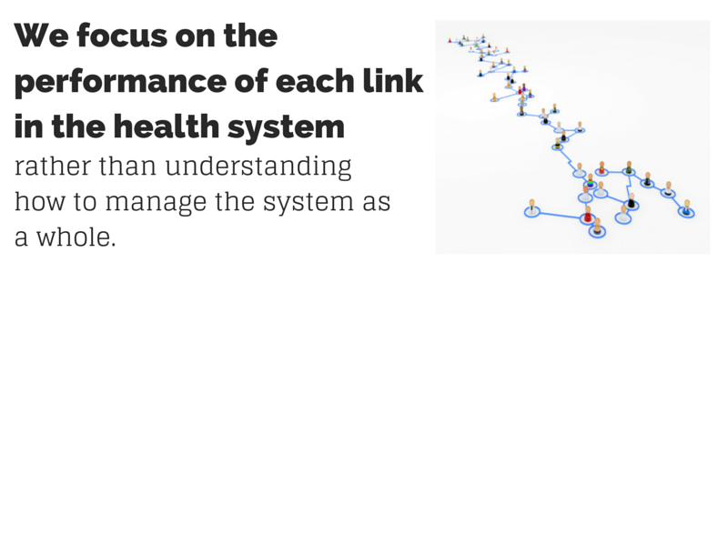
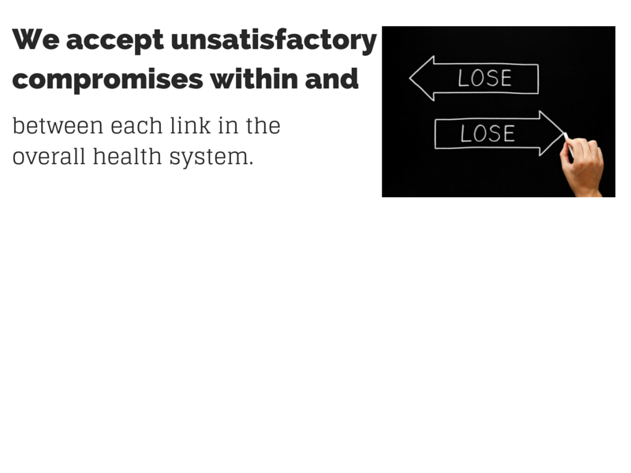
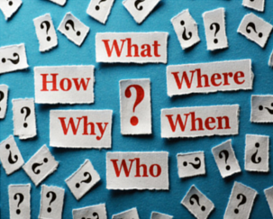

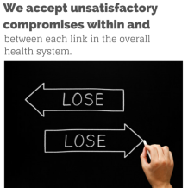
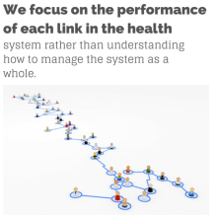
The current risks of dealing with complexity and uncertainty
We focus on the performance of each link in the health system rather than understanding how to manage the system as a whole
We accept unsatisfactory compromises within and between each link in the overall health system
We ignore the inherent uncertainty by forcing certainty on the uncertainty.
Instead we need to highlight the uncertainty and build the appropriate response.

Slide 12
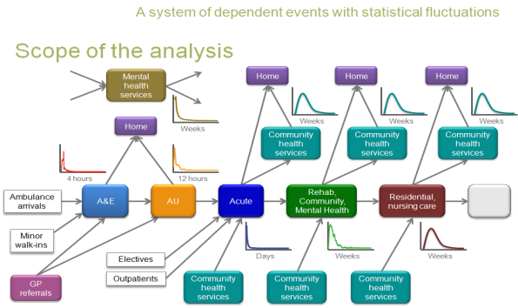
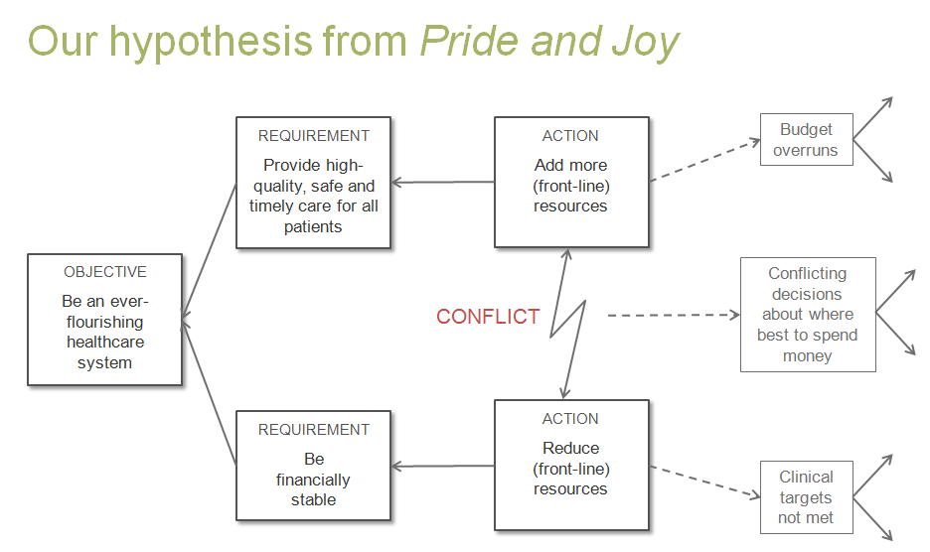
?

Slide 13
Dr Goldratt’s Theory of Constraints: the guiding principles used in measuring a seemingly complex system
The data reflects what seems to be a very complex environment.
If you look at the total number of points in the system this may be 100,000 or more.
If you look at the number of different points where, if you touch them, you will impact operating expenses then this is roughly 100.
There are few elements that dictate the performance of the whole system. The number of degrees of freedom is relatively small. This is what we call the constraints of the system.

Slide 14
The Theory of Constraints
In goal-oriented systems of dependent activities each experiencing variation (such as health and social care) there will be, in fact, only a few places limiting the performance of the entire system: the system ‘constraints’.
The Five Focusing Steps
Step 1: Identify the system’s constraint(s)
Step 2: Decide how to exploit the system’s constraint(s)
Step 3: Subordinate everything else to the above decision(s)
Step 4: Elevate the system’s constraint(s)
Step 5: Go back to Step 1.
Warning: do not allow inertia to cause a system’s constraint.

Slide 15
What does the network look like in reality?
In a healthcare environment the time taken for a patient to go through the environment is affected by these degrees of freedom or constraints.
For this reason we use time as the basis of our analysis.

Slide 16
The four critical patient flow questions
Applying Theory of Constraints in health and social care
Of all the things I could improve, which one should I improve first? (Identify)
Of all the patients I could work on next, which one should I work on next? (Exploit)
What capacity is actually needed and where by time of day and day of the week now and into the future? (Subordinate)
What is the impact on quality, safety, timeliness and affordability of care under various ‘What if’ scenarios? (Elevate)

Slide 17
Patient X’s clinical recovery period
Admission date
Clinically based planned discharge date (PDD)
Task 1
Task 2
Task 3
Patient X
Task 4
Task 5
Multidisciplinary team meeting (MDT)
Patient X is in the red zone, caused by the estimated end date of Task 2, for which the blue resource is responsible. However we can analyse the variation in task duration start and completion.

Slide 18
Time
Admission
PDD
Patient A
MDT
Admission
PDD
Patient B
Admission
PDD
Patient C
Admission
PDD
The evidence shows that the blue resource is causing most risk of delay to most patients most of the time.
Patient D
Admission
PDD
Patient E

Slide 19
Time
Resources will be synchronised as they work on patients in PDD order.
Admission
PDD
Patient A
MDT
Admission
PDD
Patient B
Admission
PDD
Patient C
Admission
PDD
Patient D
Admission
PDD
Patient E

Slide 20
Resources will be synchronised as they work on patients in PDD order.
Admission
PDD
Patient A
MDT
Admission
PDD
Patient D
Admission
PDD
Patient C
Admission
PDD
Patient E
Admission
PDD
Patient B

Slide 21




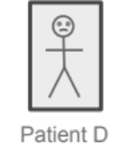
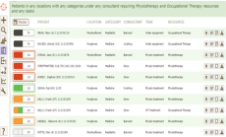


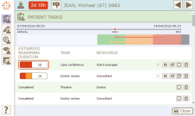

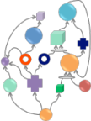

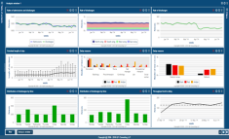
The primary objective is to improve patient flow through all pathways simultaneously
A patient-centred,
clinically led approach
A focused process of ongoing improvement
Removing local measures of optimisation
Of all the patients I could work on next, which one should I work on next?
Of all the things I could improve,
which one should I improve first?
Without removing these measures, local optimisation will continue to disrupt patient flow and stagnate the process of ongoing improvement.
PDD
Daily priorities meeting
1
2
3
Patient
priority list
PDD
Top delays meeting
1
2
3
Task
priority list
PDD
Steering meeting
Patient
plans
PDD
✕
Mis-synchronisation
Bad multitasking
Parkinson’s Law
Student Syndrome
Local efficiency
Batching
Cherry-picking
AnalyTOCs
✕
Systematically identify and address the system-wide constraint causing the most delay to the most patients
✕
PDD
✕
✕
✕
✕
21
© Alex Knight – all rights reserved

Slide 22
The basis of the breakthrough
Common assumptions
TOC response
The common way to deal with complex systems is to dissect them into sub-systems and try to manage and improve in isolation each function or ‘link in the chain’
The common way to manage or improve patient flow is to attempt to balance capacity with demand
Limitations to patient flow (the constraints) can be identified by process mapping and comparing predicted load against available capacity at the resource level
Local optima do not add up to a global optimum
Balancing flow is entirely different to balancing capacity. This is a common mistake when trying to improve such systems
The real question is: Do I have capacity when I need it? This can be correctly and easily identified through time-buffer management.

Slide 23
Pride and Joy elements
Breakthrough software that increases patient flow in a surprisingly short timescale.
Analysis capability to identify and resolve the few underlying causes of disruption and delay based on proven Theory of Constraints methodology.
Supporting strategy and tactics tree to guide and audit the implementation and results realization.
Full kit of education and supporting materials to ensure sustainability.

Slide 24
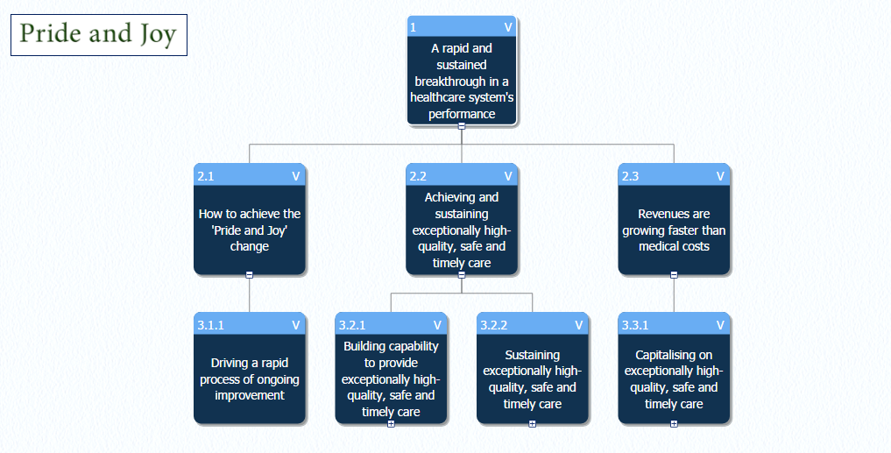

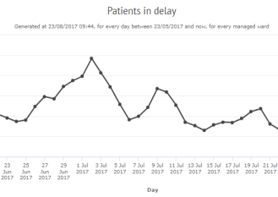
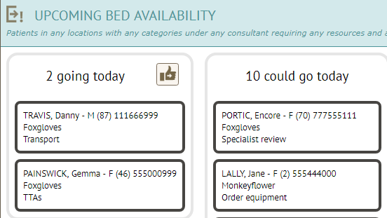
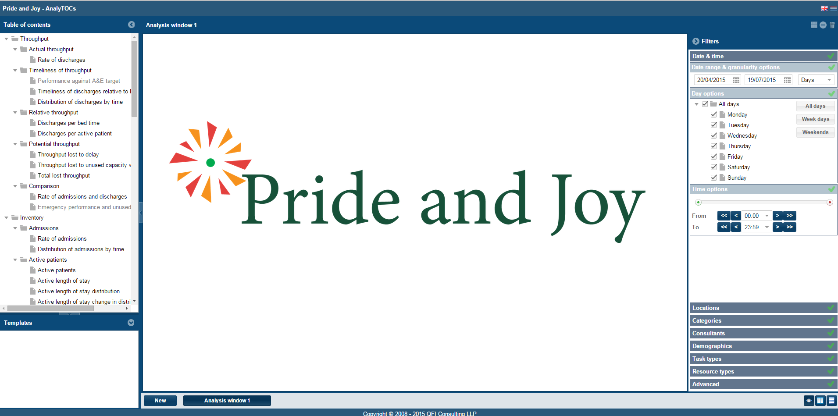
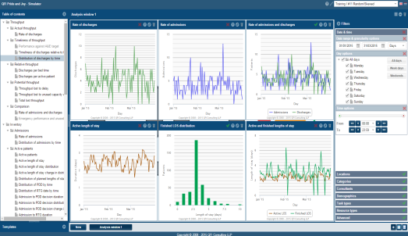

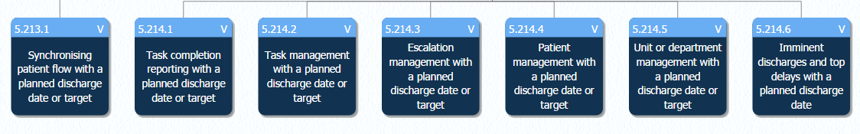
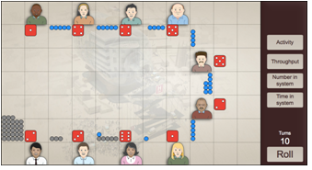

The Pride and Joy elements
Improving patient flow and simultaneously improving the quality, safety, timeliness and affordability of patient care without creating more complexity for staff

Slide 25



Results achieved from a recent implementation
“I would like to confirm the positive impact that Pride and Joy has made on a care of the elderly ward at my hospital. It is an amazing approach that helps clinicians target resources in the correct direction and decrease the length of stay.”
Dr Henry Joel Aldoradin-Cabeza, Consultant Geriatrician, Care of the Elderly
Mark Brassington
Chief Operating Officer

Slide 26



Our pilot project has started on one unit and in a month’s time we start the plan to spread across the whole hospital. So far we have taken our average length of stay from 4.9 to 3.9 days – a whole day less. It’s huge! Vinny Monteiro, Project Manager, Operational Excellence, USA
Mark Brassington, COO, England
The Pride & Joy system and approach has helped one of our most challenged hospitals make substantial improvements in length of stay, associated flow and overall bed occupancy. At a time when cost, quality and performance are all competing for our time and effort, the Pride & Joy approach has enabled us to deliver benefits that achieve all of these ends. Simon Evans, Director of Operations, Acute Trust, England
I have great pleasure in confirming the huge impact Pride and Joy made on this hospital site. The Length of Stay is consistently below 8 days. More importantly for this hospital, it helped clinicians to target the resources in the correct direction. The data collection and analysis is commendable. Mr Prabhakar Motkur, Clinical Director and Orthopaedic Surgeon, England
Dr Ruth Vander Stelt, Canada
We have reduced our length of stay from 14 to 11.5 days in a period where the social problems are growing and it is more difficult to discharge patients. Our quality of care has improved. Dr Sofia Zubiaga L, Consultant Geriatrician, Care of the Elderley, England
Sister Becky Tomlin, England

Slide 27
“Since the Pride and Joy approach started it has made us work more efficiently and in partnership. It definitively has had an impact in the care of the patient. We have reduced our length of stay and this not only has an economical impact but it also reduces the risks for hospital acquired infections, delirium and in-patient falls. It has also had an impact in the work of junior doctors so they can set up priorities for their daily jobs. Pride and Joy is now totally integrated in our daily routine. In my opinion, the keys of the success are increased awareness and team work. Gudrid A. Castejon Morales, Consultant Geriatrician-Care of the Elderly.
Mark Brassington, COO, England
Since the introduction of Pride and Joy on PICU ward I have noticed a marked improvement in the patients Pathway. I am very impressed that in six weeks there has been such a marked improvement in the patient pathway and discharge planning. Clare Walsh, Inpatient Mental Health Ward Manager, England
NHS Improvement, Midlands and East region see great value in the Theory of Constraints and the impact it can have on improving hospital flow and is pleased to see the Pride and Joy approach being used by frontline teams and being tested in Boston. Ian Hall, Head of Performance Improvement, NHSI, Midlands and East, England
Dr Ruth Vander Stelt, Canada
The use of the software as both a tool for patient flow management and also service improvement has been a revelation, enabling a better site overview for all patients and enabling priorities needed to improve patient care. Wesley Pepperdine, Acute Trust Project Manager, England
The process has assisted us to change practice and improve relationships across the health economy. I would recommend any mental health organisation to consider implementing Pride and Joy. Jackie Liveras, Deputy COO, Mental Health, England
Sister Becky Tomlin, England

Slide 28

Understanding the financial implications of increasing patient throughput

Slide 29
The differences between cost-world and throughput-world thinking are far reaching
Scenario | Revenue (£m per year) | Total variable costs (£m per year) | Throughput (£m per year) | Operating expenses (£m per year) | Profit (£m per year)
Current situation | 400 | 80 | 320 | 335 | -15
10% freed-up capacity: 5% used for protective capacity and 5% for extra throughput | 420 | 84 | 336 | 335 | 1
20% freed-up capacity: 5% used for protective capacity and 15% for extra throughput | 460 | 92 | 368 | 335 | 33
10% freed-up capacity: 5% used for protective capacity and 5% for extra throughput with double the throughput per bed day on extra throughput | 440 | 88 | 352 | 335 | 17
20% freed-up capacity: 5% used for protective capacity and 15% for extra throughput with double the throughput per bed day on extra throughput | 520 | 104 | 416 | 335 | 81

Slide 30
The differences between cost-world and throughput-world thinking are far reaching
Scenario | Revenue (£m per year) | Total variable costs (£m per year) | Throughput (£m per year) | Operating expenses (£m per year) | Profit (£m per year)
Current situation | 400 | 80 | 320 | 335 | -15
10% freed-up capacity: 5% used for protective capacity and 5% for extra throughput | 420 | 84 | 336 | 335 | 1
20% freed-up capacity: 5% used for protective capacity and 15% for extra throughput | 460 | 92 | 368 | 335 | 33
10% freed-up capacity: 5% used for protective capacity and 5% for extra throughput with double the throughput per bed day on extra throughput | 440 | 88 | 352 | 335 | 17
20% freed-up capacity: 5% used for protective capacity and 15% for extra throughput with double the throughput per bed day on extra throughput | 520 | 104 | 416 | 335 | 81
Explaining the connection between a reduction in length of stay and the finances is key.
The direct impact of eliminating unnecessary expenses and delivering improved service levels is clear.
However, the indirect impact on freeing up capacity to increase the number of patients treated without any further addition to operating expenses is much greater.
Higher quality, safer and more timely care can be achieved while simultaneously transforming the finances of the health and social care system.
Asset utilization can be dramatically improved.

Slide 32
Understanding the role of software in increasing patient throughput

Slide 33






Apparent complexity of the acute environment
Community hospital(s)
Home
Social services
Home
Home
Weeks
Surgical ward(s)
Specialist ward(s)
Medical ward(s)
Weeks
Home
Home
Days
Days
12 hours
Resources:
Operating Room
Assessment unit(s)
Home
Mins/Hours
4 hours
Home
Outpatient schedule
Emergency department
Home
GP referrals
Minors
Majors
GP referrals

Slide 34
Apparent complexity of the acute environment
Community hospital(s)
Home
Social services
Home
Home
What is the power of the technology
What limitations to business performance does the technology diminish?
What rules, behaviors or measurements have the users developed to enable themselves to live with their original limitations?
What rules should the company adopt once the technology has removed the limitation?
Is the technology aimed at fostering new rules?
How do you implement the organizational change on which effectiveness of the technology depends?
Weeks
Surgical ward(s)
Specialist ward(s)
Medical ward(s)
Weeks
Home
Home
Days
Days
12 hours
Resources:
Operating Room
Assessment unit(s)
Home
Mins/Hours
4 hours
Home
Outpatient schedule
Emergency department
Home
GP referrals
Minors
Majors
GP referrals

